Slide 1


PRACTICAL INFORMATION I. SUMMARY
Orientation Week / Winter Semester 2020/2021

Slide 2
Information Summary
Coordinators at UP:
Incoming student coordinators - central IRO – general confirmations/information
Faculty coordinator (Faculty IRO)- academic issues – online registration, final ToR
Departmental coordinator (academic staff person = responsible person for LA)
Registration of courses at UP:
online(STAG) all students must have their courses registered in STAG
paper (yellow card) - required at 3 UP Faculties: Medicine, Health Sciences, Theology - registration done by the Faculty coordinator based on the yellow card (enrolment form)
Deadline to bring the yellow card to the Faculty coordinator – upon agreement/end of September 2020

Slide 3
Information Summary
Classes start officialy on Monday, September 21, 2020! Check email from coordinators! Write to your departmental coordinator!
Exchange students must be enrolled FULL TIME and receive minimum 15 ECTS per each semester, Erasmus International Credit Mobility students must receive min. 20 ECTS per each semester
You must notify the IRO if you decide to cancel your stay before the official end of classes.
You must notify the IRO as soon as possible of any change of address, legal name, and/or change of your major. If you do not live in dorms you must provide the IRO with an address of a place where you stay in.
Visa students must report any change of accommodation to the Dept. for Asylum and Migration (OAMP). An appointment there is scheduled by sending an e-mail request to IRO, namely to Ms. Yvona Vyhnanková (yvona.vyhnankova@upol.cz)
Mind the Smoking Ban in restaurants, public places!

Slide 4
Information Summary
Students of EU countries staying out of the campus (staying in a private apartment) are in a duty to report a place of their stay to the Foreigner´s Police Dept., Smetanova 14, Olomouc within 30 days after the arrival
https://goo.gl/maps/NSnhDA6RnuL2
You need to take an accommodation contract in Czech language, fill in a brief form (available in IRO or at the Police dept.), ID/passport

Slide 5


ISIC + UP ID Card = two in one
450 CZK (200 deposit + 250 brand payment)
Valid till December 2020
UP Standard Blue Card
200 CZK deposit
Valid for the time of your study stay

Slide 6
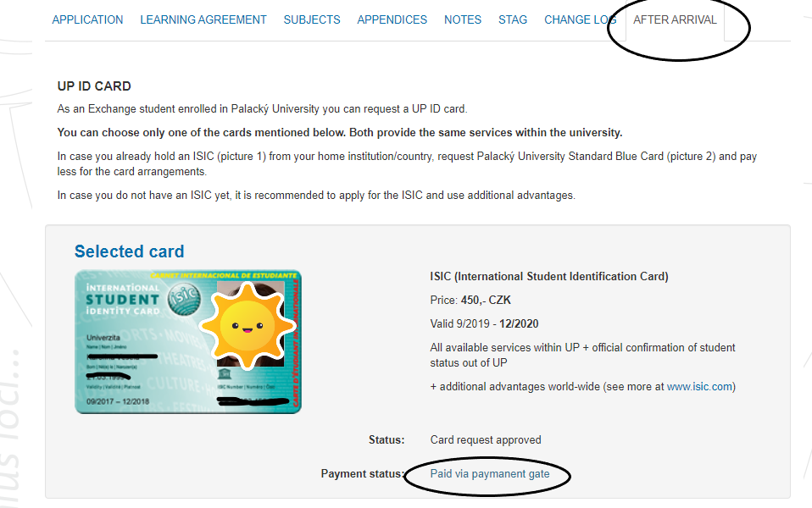

Slide 7
Notification email when the ID card is printed - 2020
Dear student,
This is an automatically generated e-mail, please do not reply.
Please note that your personal UP ID Card is ready for pick up. It will be issued in the ID Card Office in “Zbrojnice” (the Armoury building), Biskupské náměstí 1, 2nd floor, room no. 3.87
Students must use the reservation system to apply for picking up of the ID card at https://rezervace.upol.cz/karty
Additional information please find on the website of the ID card office https://cvt.upol.cz/en/identificationcards/#c6366
If, for any reason, you do not manage to schedule the appointment, please come within the office hours (see the web).
September 28, 2020 – office will be closed due to a national holiday
Always state that you are an Erasmus exchange student. Have your ID/passport ready to prove your name to speed up the distribution of the cards.
Please wear a mask and keep the social distance even if you come with your fellow students. There should not be any gatherings of students in front of the ID card office. Please enter the office individually, not in a group!

Slide 8
European Health Insurance Card (EHIC)
Registration of the valid health insurance will be arranged via International Relations Office, a copy of a valid EHIC is required.
Upload a copy of VALID EU health insurance card/document into the Online Application /Appendices during the first week of stay at the latest!
Only valid insurance can be registered.
When the registration is approved, students will be notified via e-mail. If you need to prolong the registered insurance, contact the International Relations Office, Křížkovského 8 or directly the insurance company – see the address in the document.
Current registration only until January 31, 2021!

Slide 9
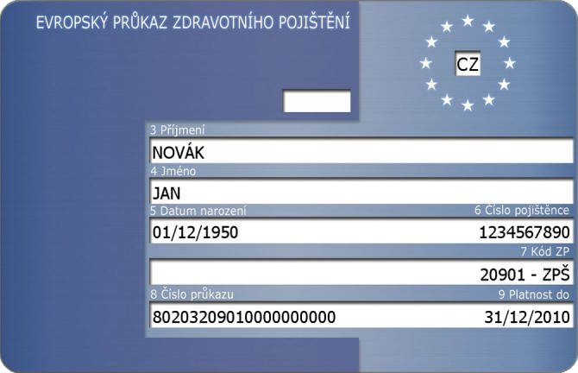
Check the date

Slide 10
Counselling & Medical Care
Special Needs Centre
Address and contact: Faculty of Education, Žižkovo nám. 5, Olomouc,
tel.: +420 585 635 323, mobile phone: +420 775 124 696,
email: lucia.pastierikova@upol.cz
Psychological Counselling
the Counselling Centre of the Department of Psychology and Psychopathology, FoE, UP. Email: jana.kvintova@upol.cz. Likewise, students can get psychological help at the UP FoM. Contact the Study Department for more.

Slide 11
For other medical specialists and services, visit the main Olomouc healthcare centres such as:
Health Centre "Poliklinika" Olomouc, třída Svobody 32
  www.poliklinikaolomouc.cz
  Health Centre „SPEA“
  nám. Národních hrdinů 769/2, 779 00 Olomouc
  www.spea.cz
  Olomouc University Hospital, I. P. Pavlova 6
  www.fnol.cz, www.fnol.cz/pdf/fnol_cz_mapa.pdf

Slide 12
Medical Care and Services
Students with EHIC (EU citizenship + EU residence permit) –insurance registration in the CR required – IRO assistance
Students from visa countries (commercial comprehensive medical insurance – assistance services included)
https://www.upol.cz/en/covid-19/ - check the info + update
Emergency Ward in the University Hospital – urgent cases (weekend, night)
Army Hospital/Klasterní Hradisko – 8 - 11a.m. urgent problems
Any GP upon appointment – check the web, EHIC+ registration document required
Need assistance – contact IRO or UP Faculty coordinator

Slide 13
COVID-19 prevention and health guidelines https://koronavirus.mzcr.cz/en/
COVID-19 information hotline (dial 1221) is also available in English from anywhere in the Czech Republic on weekdays from 8 a.m. to 7 p.m. and on weekends from 9 a.m. to 4:30 p.m.
Health and safety – priority – simple and clear – be smart!
UP students protect UP students! We protect you and you protect us!
Social responsibility of (young) people, compliance with the rules, responsibility for consequences!
Covid-19 – deadly serious – none of us is safe unless we all are safe – be smart, rely on facts and and use common sense
Remind February/March 2020 outbreak to avoid similar situation
One bad bar party - spread of the virus
Outbreak any place - outbreak everywhere

Slide 14
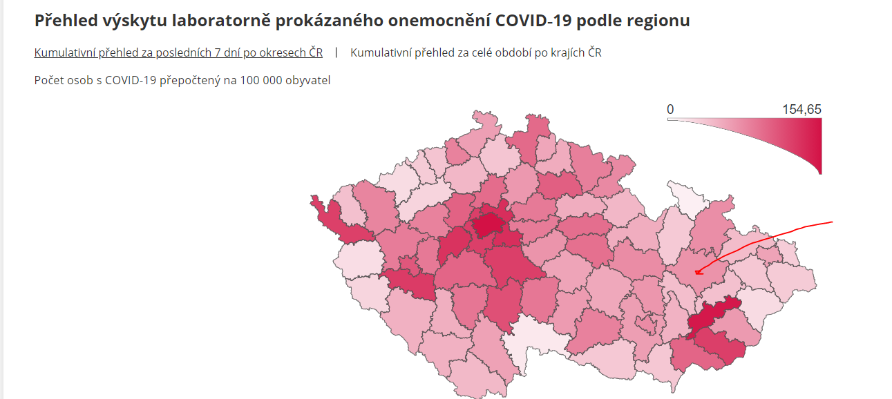
https://onemocneni-aktualne.mzcr.cz/covid-19/stupne-pohotovosti

Slide 15
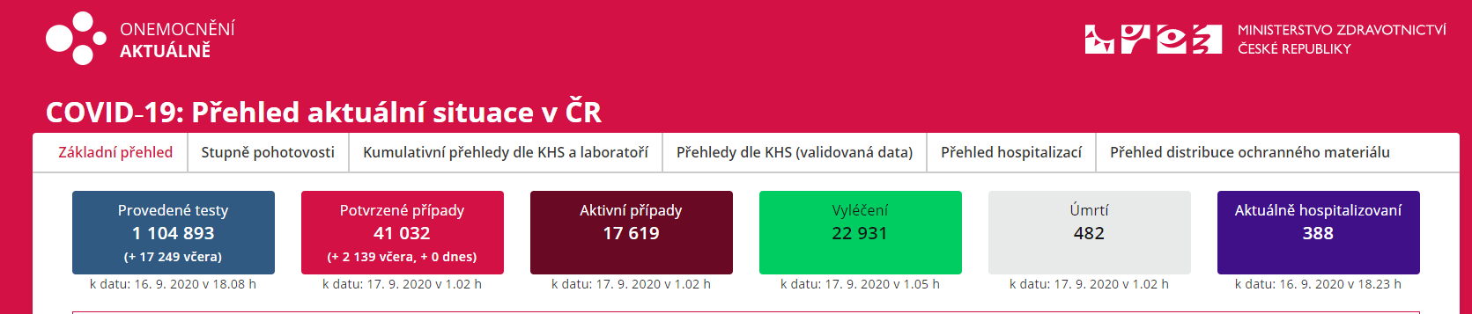
COVID-19 in the Czech Republic update 16.09.2020

Slide 16
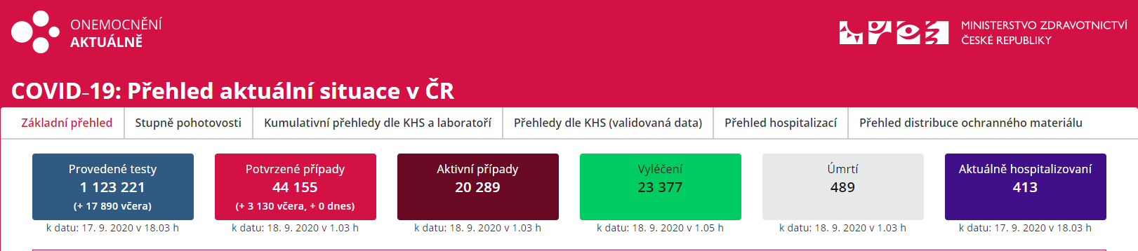
COVID-19 in the Czech Republic update 17.09.2020

Slide 17
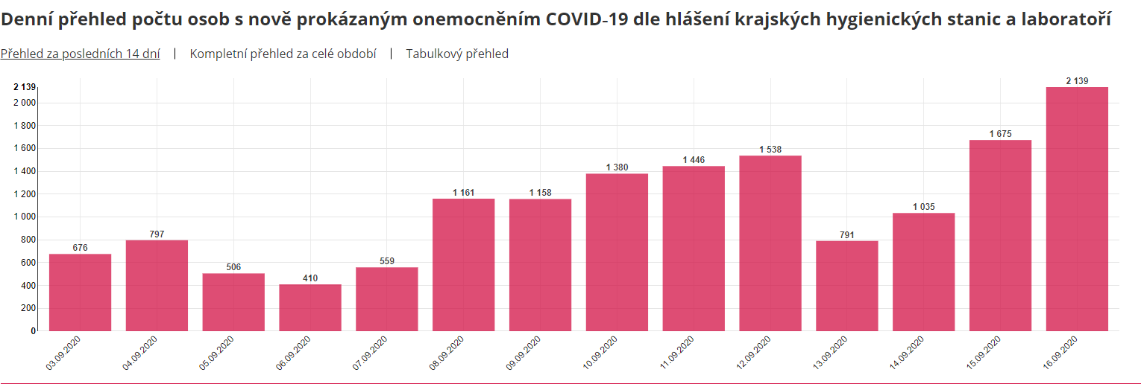

Slide 18
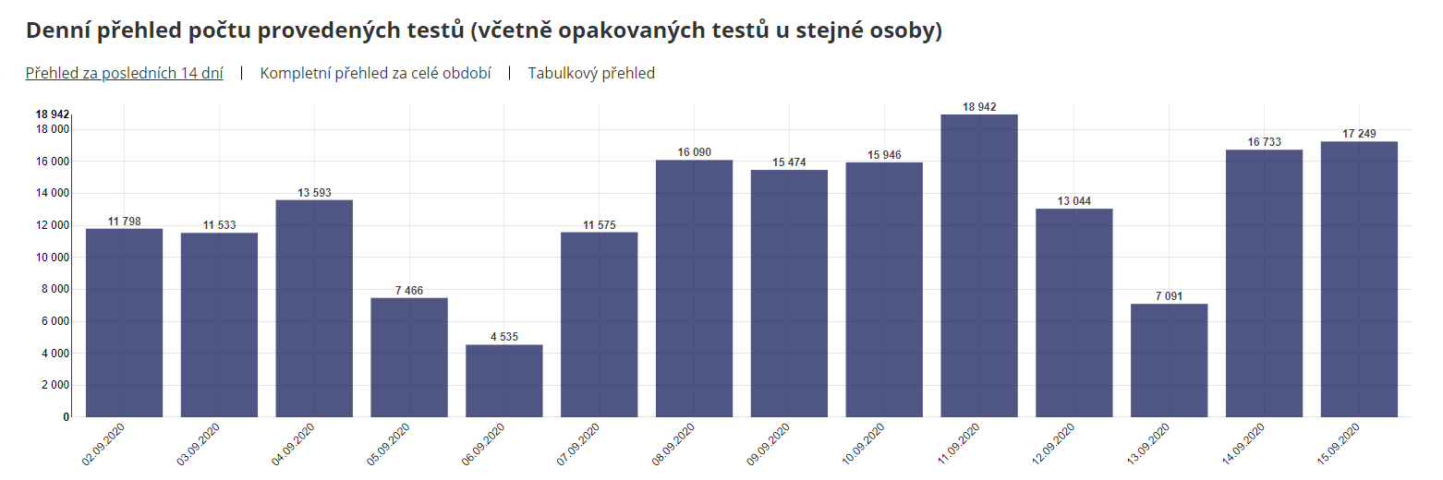

Slide 19
Recommendations
Limit traveling – learn more about Olomouc
Olomouc is a unique historical place – discover its beauty in detail, go sightseeing.
Keep fit in green areas – jogging, walking, yoga in Olomouc parks.
Go for a tour/afternoon trip in the vicinity of Olomouc – e.g.visit the zoo.
Concentrate on your studies, read, listen to music.
Get inspiration and good tips for leisure time activities from ESN UP.
Eat healthy food /vitamins
Remember which places you visited, whom you met in the past week/days

Slide 20
Testing after the arrival/ duties after the arrival
Duty to inform the public health authority representative (KHS) about the entry in the CR the same day or the following day.
Duty to fill in and send a questionaire by email to the KHS – based on instructions provided by IRO
Duty to forward the official test result to KHS within 72 hours after the entry, if not, quarantine in place for 10 days
See the web for more info and required forms at https://www.upol.cz/covid-19/ or https://www.upol.cz/en/students/guide/counselling-medical-care/
Keep updated - https://koronavirus.mzcr.cz/en/current-measures/
https://www.mvcr.cz/mvcren/article/coronavirus-information-of-moi.aspx

Slide 21
How to arrange testing in Olomouc?
Covid-19 - RT_PCR test - where to go, how to apply, how much to pay?
University Hospital (Fakultní nemocnice /FNOL) - https://www.fnol.cz/aktuality/information-for-self-payers-sars-cov-2-pcr-examination
Klášterní Hradisko (Army Hospital)
Online reservation system
After arrival and any time you want to take the test – you pay!
Test ordered by a GP – test paid by insurance company
1740,- CZK(test) + 250,- CZK(certificate)
Buy a Czech SIM card and use a Czech telephone number! (ask ESN UP)

Slide 22
Czech For Foreigners´Courses
Survival Czech Course / a lecture during orientation week
Semester course / two 9o min lessons per week
Placement test: Not for beginners !
Test assignment available at www.kb.upol.cz (Czech for Foreigners, Erasmus), deadline for sending the test is September 20, 2020. Results will be sent to the e-mail address of the sender.
To view the timetable - check the web: www.kb.upol.cz or information board in the International Office.

Slide 23
Czech For Foreigners´Courses
CJPC1– Czech for Foreigners – course – 4 ECTS
CJPCZ1 – Czech for Foreigners – exam – 1 ECTS

Slide 24
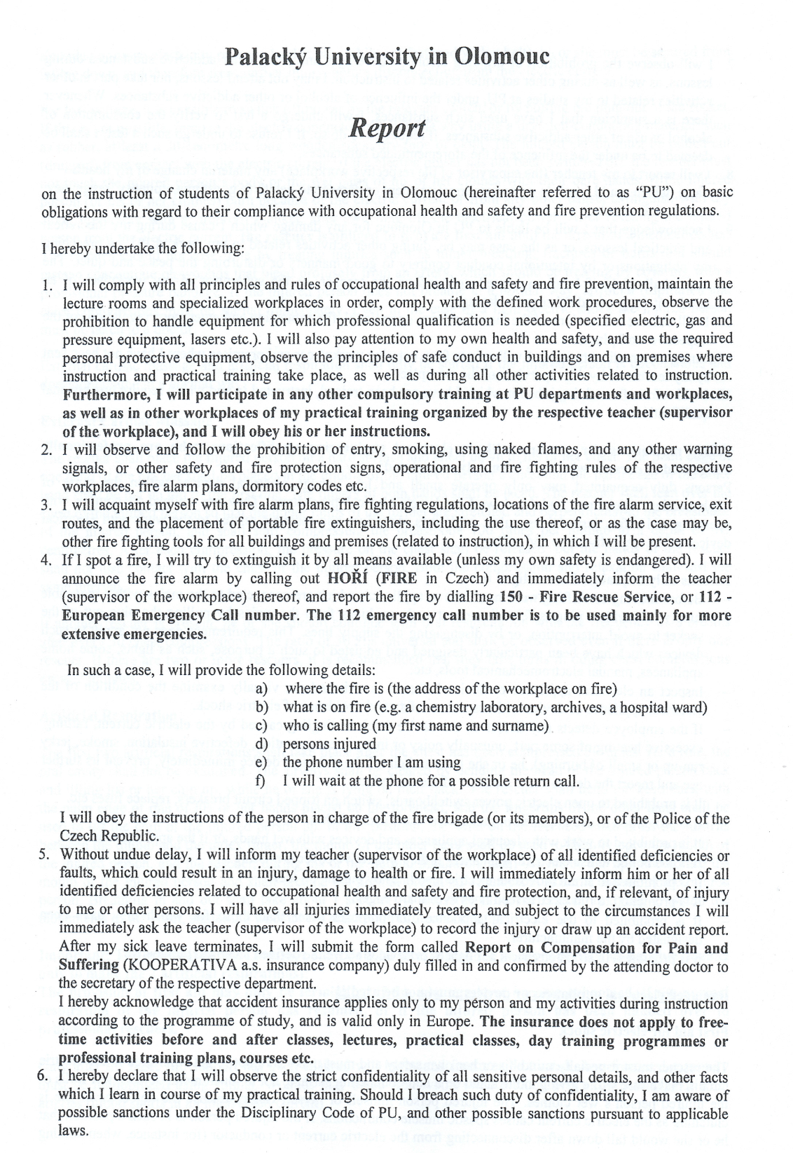
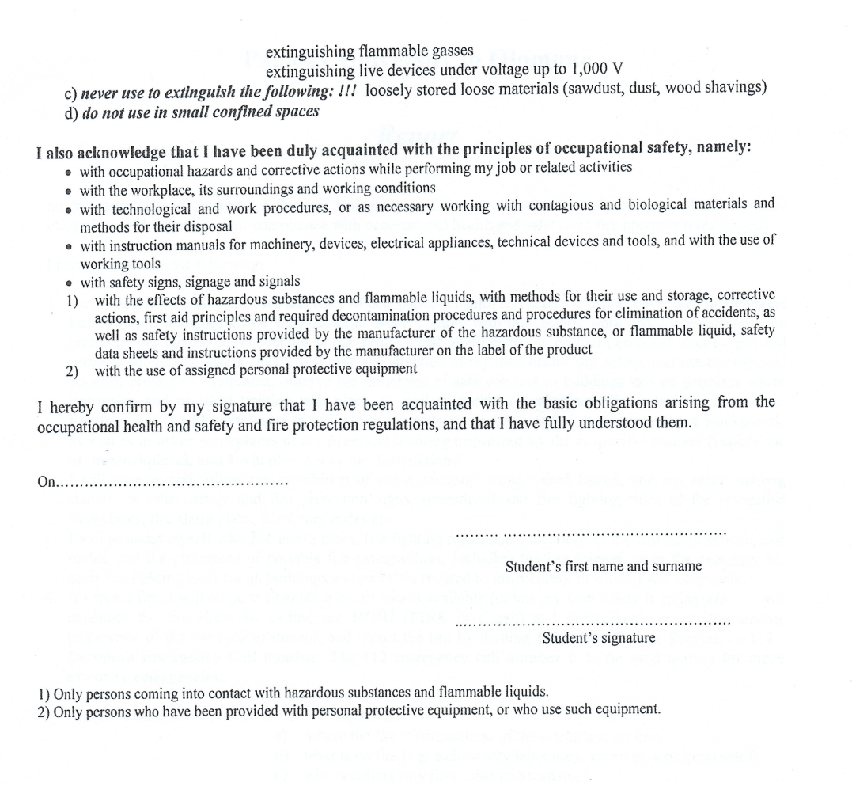
Please sign on the last page
Current Date
Name
Signature

Slide 25
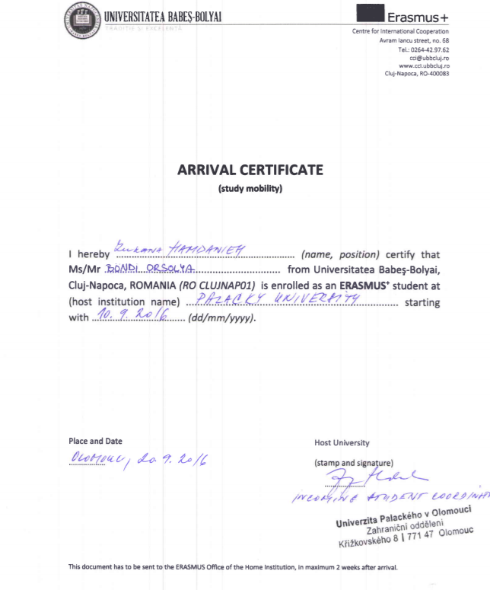
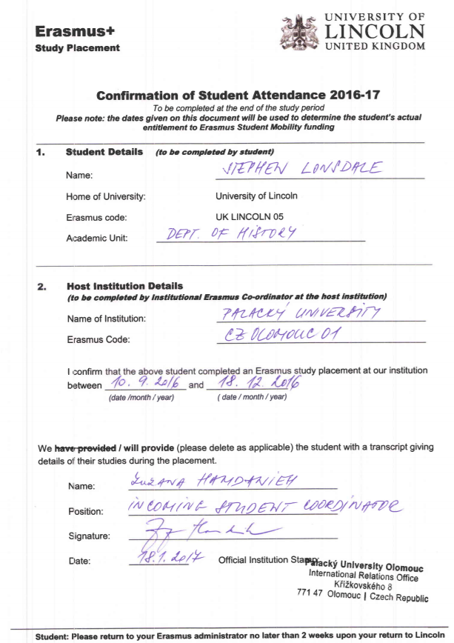
Confirmation documents – arrival certificate not required by all institutions – check instructions of your home institution
At the end of a study stay
At the beginning of a study stay

Slide 26
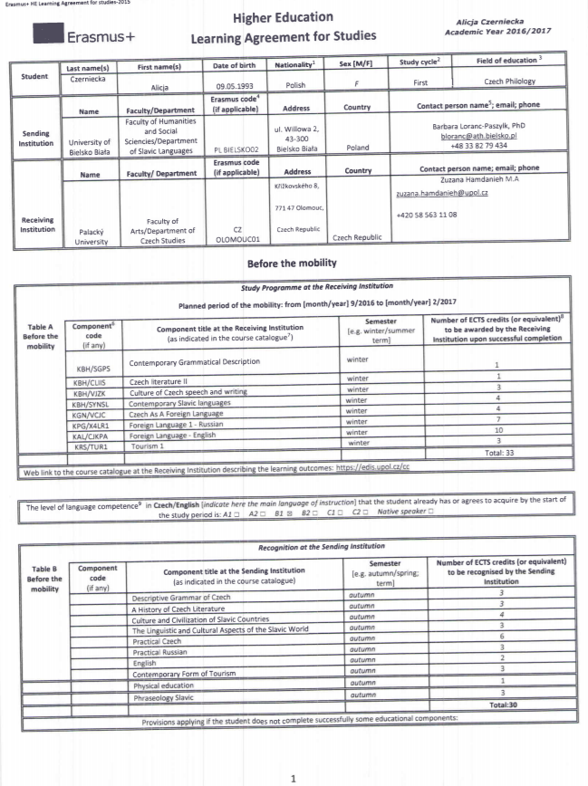
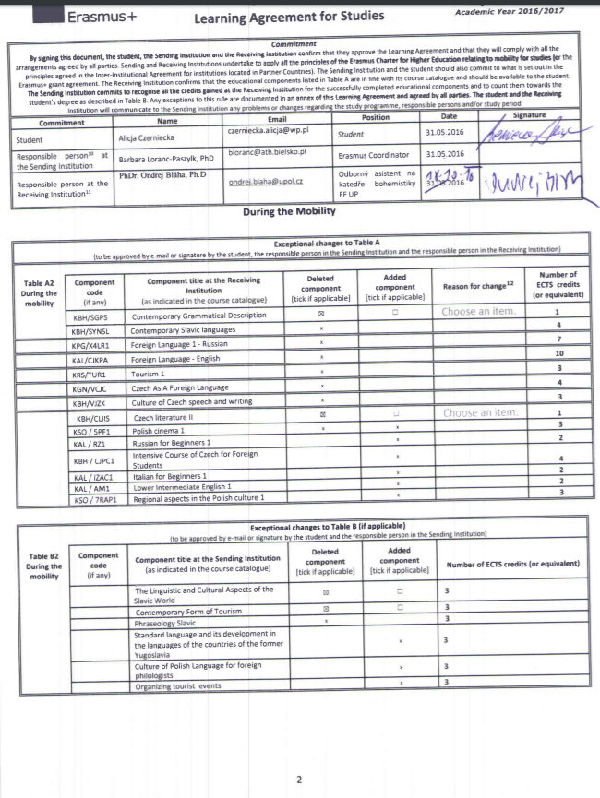
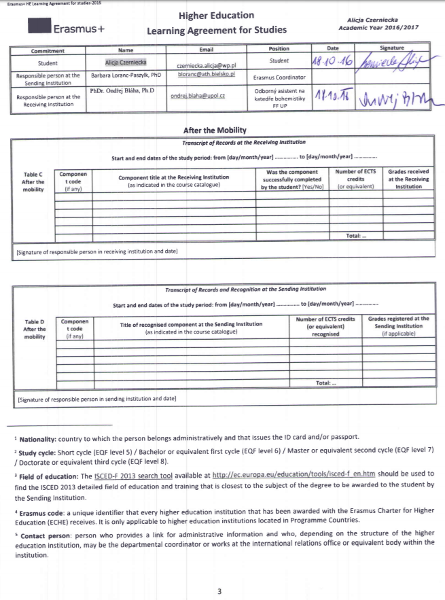
Learning Agreement
Before mobility
During mobility
After mobility

Slide 27

Staying at Palacký University Dormitories
Read your contract!
If you change the date of your departure, inform the accommodation office and have a change recorded in your contract, one month notice period!
Rent is always paid for a whole month!
Keep the rules – mainly: no noise during night hours, no alcohol, drugs, smoking, keep your place and cooking areas clean, no pets are allowed, return the key of the laundry room in time, otherwise you pay for extra time! ….
Breaking the rules can cause an end of your stay there, your home institution will be informed! Any damage caused by students is taken off the deposit.
Any changes, you do in dorms, must be approved by the accommodation office, you must personally report them in the accommodation office in advance.
„Shopping carts are the property of the shopping centers –
e.g.Globus/Albert supermarket!

Slide 28
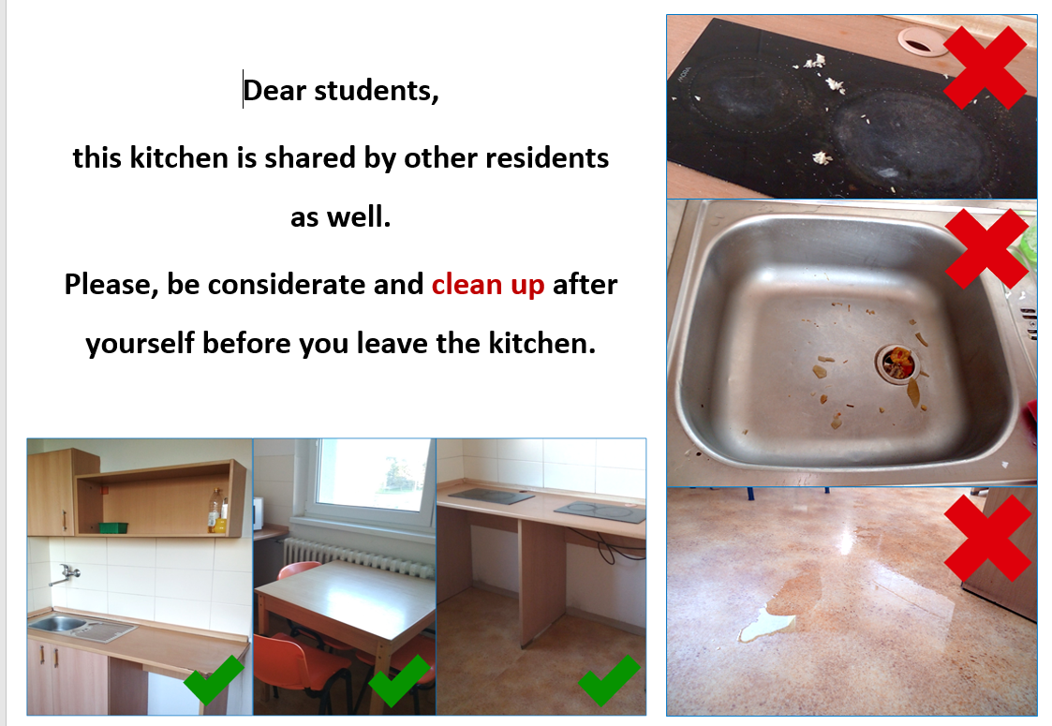

Slide 29
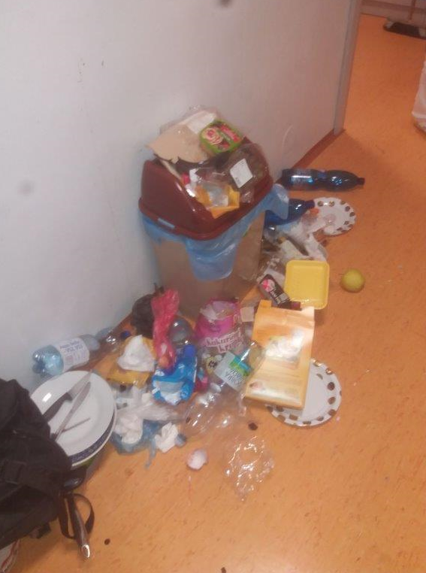

Slide 30
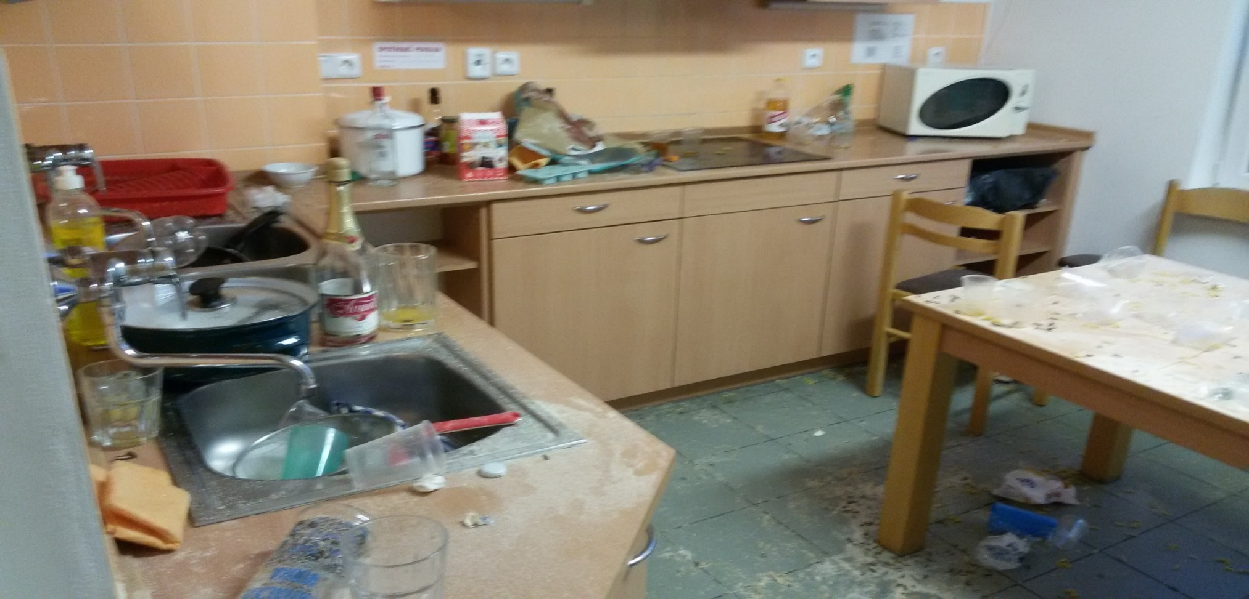

Slide 31
My house - my castle
Would you like your home to look like the rooms in the pictures?
Of course, not!
Every time you cook /prepare meals you must clean the kitchen area after you . This is not the work of dormitory cleaning staff !
It is forbidden to bring garbage from the room to the kitchen!
Every extra garbage (paper box, plastic/glass bottles etc.) is the responsibility of the student who must keep the room clean and in accordance with hygienic rules

Slide 32
Accommodation Subsidy
A portion of money given to Erasmus+ (KA103) students to support their accommodation expenses
Winter semester portion is paid for October – Nov/Dec – 3 months 760,- CZK per month
Always available at the end of the semester (in Dec) at the main cash desk, Křížkovského 8
Subsidy cannot be paid in advance
Paid in cash (CZK)
Only in person, no friend
No application form
Necessary to inform the faculty coordinator about a departure date if your stay ends up earlier.

Slide 33
Waste Management Municipality Fee
Required from everybody staying in Olomouc for more than 3 months ( 90 days)
Fee of 816 CZK per year
Information available on the web
Payment is requested by the Municipality of Olomouc, Economic dept., office of municipal fees, based on the Municipal Council decision (order no.14/2019).
- Information is also available on the web of the town (in Czech language):
http://www.olomouc.eu/aktualni-informace/aktuality/15246
UP web/Accommodation na Dining (in English):
https://skm.upol.cz/en/accommodation/for-international-students/#c16609

Slide 34
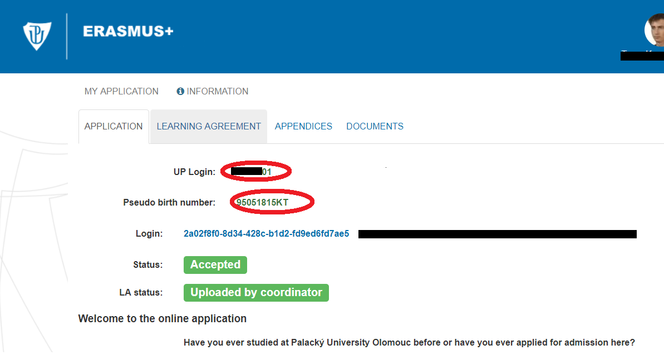
Access into the UP online application after arrival
Via link received at the very beginning of the application process
Via UP Portal – using UP login (Portal ID) and password
Haven´t received a notification e-mail with UP login and password?
Check information in the online application! Contact IRO!

Slide 35
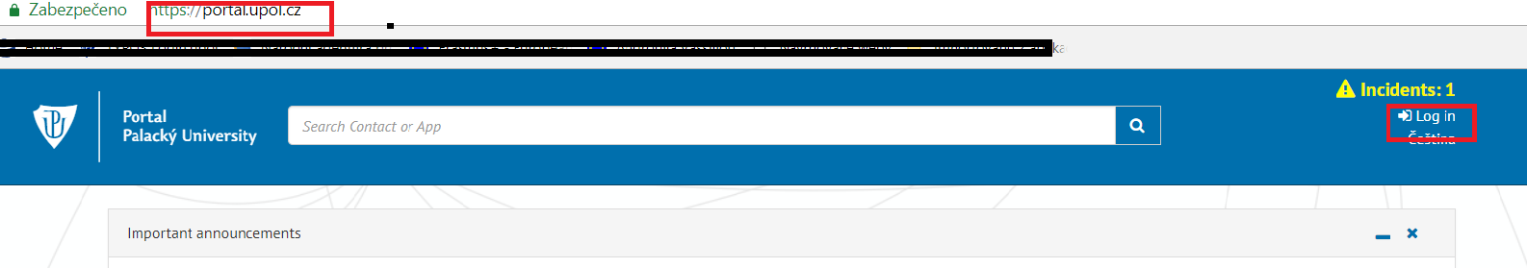
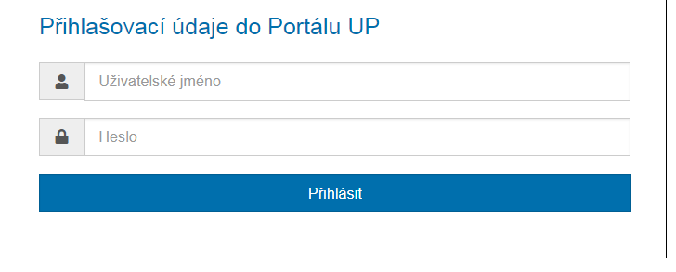
Using UP Portal

Slide 36
Using UP Portal

Slide 37
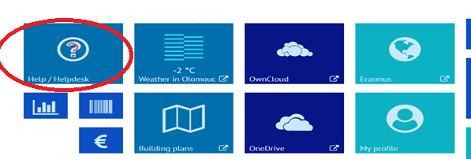
Information sources
Visit the web of IRO at https://www.upol.cz/en/students/
Visit the web of your UP Department/Faculty
FB
Current password to UPOL Wifi network is: studujup2020
A new password you can view in Portal via Help/Helpdesk

Slide 38
Meeting Departmental Coordinators
(Responsible Persons) – list of all available on the web https://www.upol.cz/en/students/exchange-students/departmental-coordinators/
Political Science Dept. (FoA)
Ms. Markéta Zapletalová
Wednesday, 23.09. 2020 at 10.30
Křížkovského 12, room 1.09
English Dept. (FoA)
Ms. Markéta Janebová
Tuesday, 22. 09. 2020 at 16.00
Krizkovskeho 10, room 3.16, 2nd floor

