Slide 1
Interdisciplinary COURSE OFFER
SUMMER SEMESTER 2018/2019

Slide 2
Social and cultural anthropology Summer Semester 2019 Couse code: KKS/KSAM Instructor: Selma Porobić, Ph.D.; Mgr. Ivana Ljuština
What is culture?
Are there human universals?
How are our societies different or same?
If these questions occupy your mind, then this is the course for you!
This course aims to provide an overview of critical issues that define the social and cultural anthropology as a discipline. The aim is to introduce students to central concepts such as ‘culture’, ‘society’, the notion of the ‘other’, as well as the relationship between ‘nature’ and ‘culture’, and local and global worlds. Through the assigned texts and articles, we will explore issues of the belief systems, social relationships, economic and environmental contexts, gender roles, and international and intercultural relationships of a number of cultures and the potential biases, as well as the varied perspectives of the socio-cultural anthropologists who studied them.
On completing this course, you should have a broad understanding of both what people have in common and the vast variety of social and cultural institutions, and comprehension of the ways in which cultures interact and change over time. We also stress the development of your fieldwork skills like participant observation - typical to anthropologists, which will enable you to assess the everyday patterns of the various cultures you encounter and work with.

Slide 3
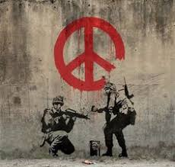
Peace and Conflict Lecturer: Agnieszka Zogata Kusz, Ph.D. When: 8.30 to 12.40 on Thursdays: 28.03., 4.04., 11.04., 25.04. Where: Building Na Hradě 5, 4th floor, room H2 (with the exception of 28.03, then in 4.11a)
Are you interested?
Defining and explaining conflict
What is conflict?
What is new about wars in the today world?
What is the relation between conflict and violence?
Why do conflicts happen?
Peace and peacebuilding
What is peace?
Is it possible to transform conflict into peace?
What is conflict mapping and what do we need it for?
Aid and peacebuilding
What is civil society peacebuilding?
How can we fuel conflict and violence?
How can we bring a positive change?
The aim of this course is to provide a general overview of key factors and mechanisms causing conflict and enabling peace, as well as to provide a critical grounding in the analysis of examples of intra- and international conflicts and post-conflict peace building. Students will understand the root causes of conflict and study the peace outcomes for societies, and communities. They will learn the basics of conflict mapping and conflict-sensitive approach in aid. They will study the role of civil society in peacebuilding and learn on concrete examples of bad and good practice in providing aid.

Slide 4
The Rise and Fall of the British Empire 2019 Summer Semester, Course Code: KHI/RFB Tuesday: 11:30–13:00 Instructor: Dr. Lukas Perutka
This course presents the history of the British Empire from its establishment in the 16th century to its dissolution during decolonization process of the 20th century
Why the British controlled the empire on which the sun never sets?
How were the British able to overcome other colonial powers like Spain, Portugal, Holland and France?
How the British organized its empire in Asia, America, Africa and Australia?
Why the British empire declined and how it was decolonised in the 20th century?
What remains from the British empire and what was its importance for the development of the modern World?
The course The Rise and Fall of the British Empire will be focused mainly on some of the important patterns regarding the biggest domain of the world - history, economy, social structures, and international relations. Also, every important part or region will be presented in comparison to the others.
This course is taught in English.

Slide 5
Community Based Apporach and Intervention Methodology Summer Semester 2019 Joined course codes: KKS/CBADP and KKS/IMBRC Instructors: Selma Porobić, Ph.D.; Mgr. Ivana Ljuština
Who means what when they say "community work" and "development"?
How does that relate to policy, politics and practice in post-conflict contexts?
How do people learn to live together in the aftermath of violent conflicts with devastating effects on the community cohesion and social relations?
How do they maintain the mental and cultural space necessary to encounter ‘different’ others?
If you want to discuss these questions and understand what lessons we, as future community practitioners, can derive from social anthropology, sociology, psychology, social work and development in relation to resilience and vulnerability, religion and spirituality, class, poverty, youth and gender, then this course is for you!
This year’s course offers specific insights and lessons on the Pragmatic Empowerment Training (PET) - the long-term peacebuilding community work, developed and taught by dr. Charles Tauber from the Coalition for Work with Psychotrauma and Peace in Croatia.

Slide 6
DIALOGUE BETWEEN NATURAL SCIENCES AND RELIGION
Welcome believers as well as non-believers to this new domain, which demonstrates its need for today against all shades of fundamentalisms. How? By keeping alive ancient Isaiah’s call: “Come now, and let us reason together! “
- Intro to Dialogue Science-Religion
- Neuro-Sciences and Religion
- Open versus Closed Systems
- Non-Christian Religions and Science
- New Phylum of Christianity where Evolution is already inserted
Annotation:
• Seminars are for religious as well as non-religious students to enrich their views on these two domains, natural sciences and religion.
• Code: KST/DNSR (Instructor: ThLic. Ing. František Mikeš, Ph.D.)
• Semester: 11.2.–14.5.2019
• First Class: 13.2.2019, 17:20-18:55
• Building and Room: UN-U11 (Univerzitní, 22)
• Form of Ending: Combined
• Credits: 4

Slide 7
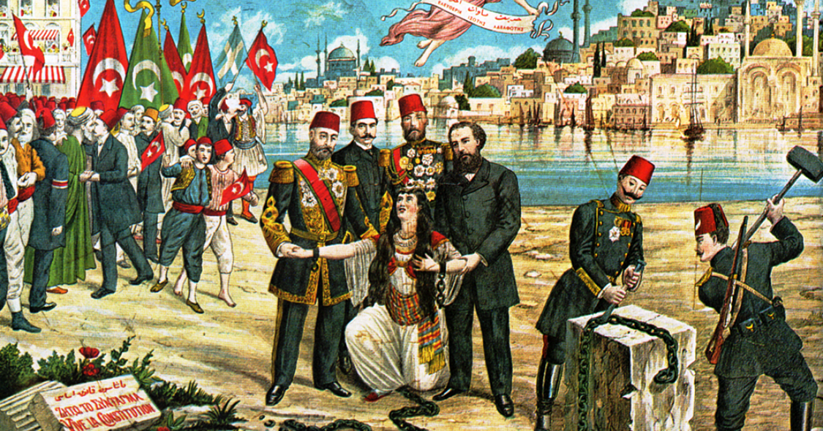
History of the Modern Middle East 2019 Summer Semester, Course Code: KHI/HMME | Monday: 11:30-13:00 Instructor: Dr. Yasir Yılmaz
*) Results from conference in Mumbai, India, 9-11 Feb. 2017
This course covers the history of the modern Middle East from Napoleon Bonaparte’s invasion of Egypt (1798-1801) to the present day.
Where is the Middle East? When and why did the region rise to prominence in world politics?
Tanzimat: How did the struggle between tradition and modernity begin in the Middle East?
The rise of Arab nationalism, the Armenian Genocide and the First World War
Oil, Arab-Israeli conflict, the Iranian Revolution, and the Arab Spring
Always on the news and in the headlines, the Middle East never disappears from our radar of politics, culture, and economics. This course will introduce an outline of the modern history of the region.
This course is taught in English.

Slide 8
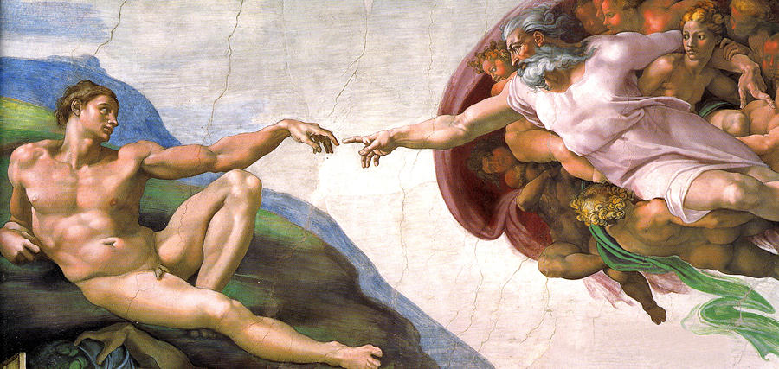
Europe: User's Guide
Monday 14:00–14:45
Code: KSV/VA011
2 Credits
Exam based on student´s papers
Building and room: UN-U11
(Univerzitní, 22)
The basic introduction into the European values and into roots of European culture. The course is tailored especially to students from non-European cultural background. It presents a basic hermeneutical key to the modern European society.
1. Paradigms of the European thought (Charlie Chaplin´s movie Modern times, 1936)
2. Freedom and totality in the history of Europe (Václav Havel, The Power of the Powerless)
3 Atheism, unbelief and indifference (M. P. Gallagher, What are they saying about unbelief?)
4. Reason, Faith, Spirituality, and Religion (Rolanda Joffe´s movie The Mission, 1986)
5. Interreligious and intercultural dialogue; Judaism, Christianity, Islam.

Slide 9
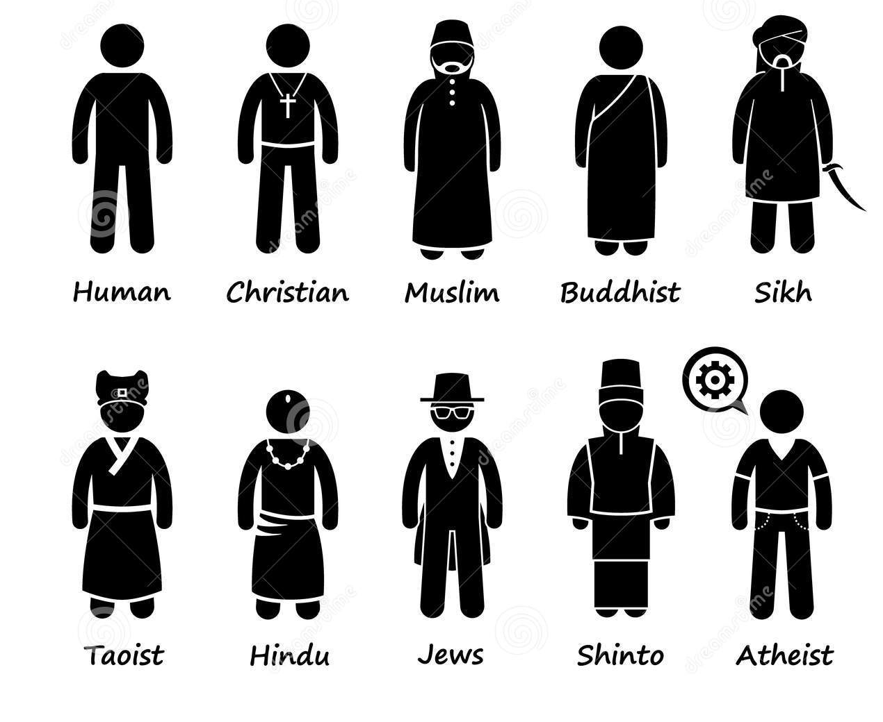
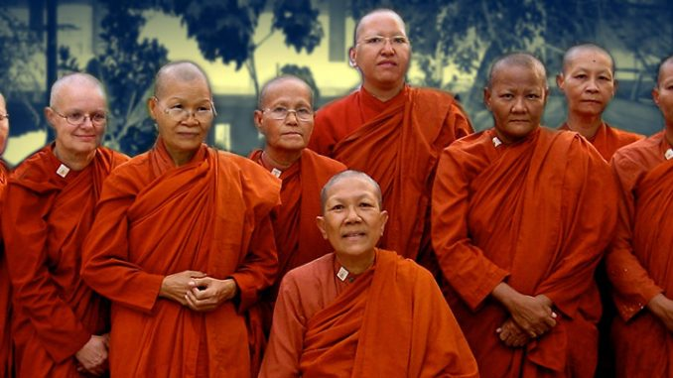
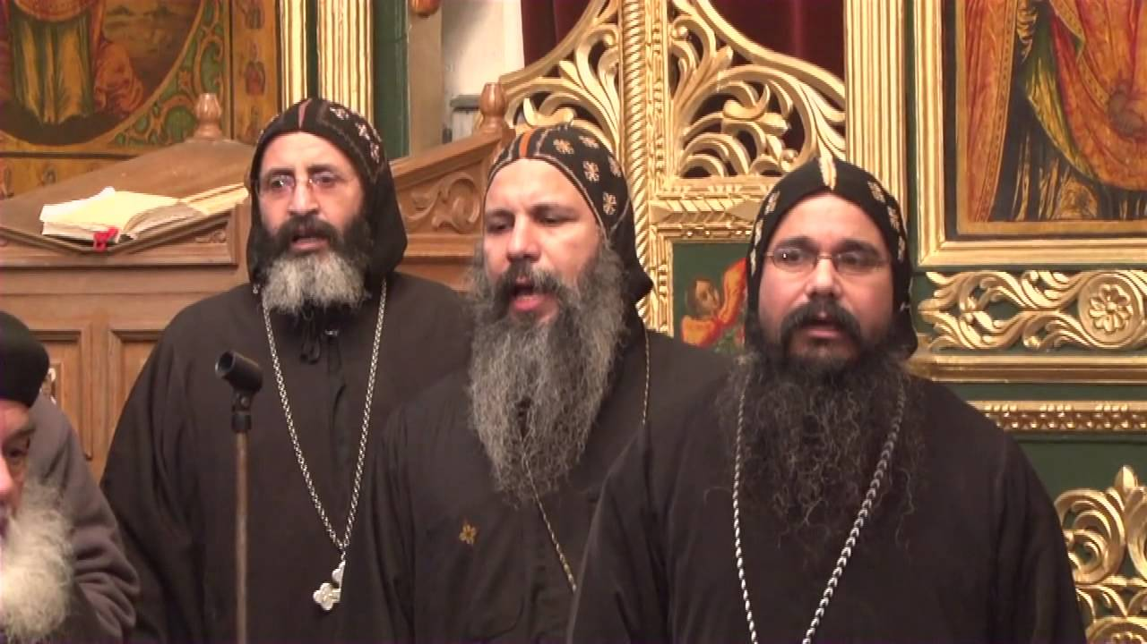
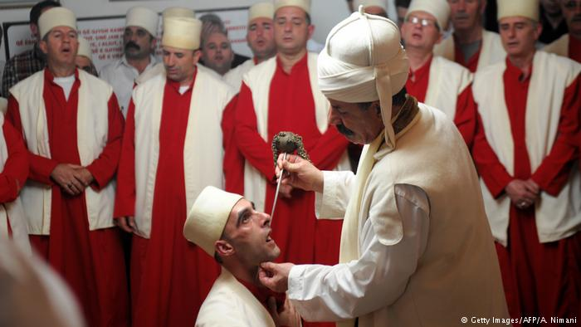
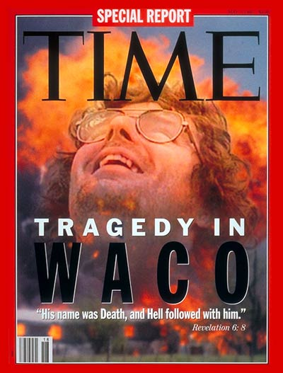
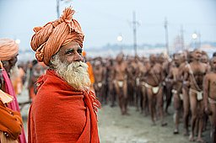
RELIGIOUS STUDIES
Tue 14:00-15:30
Code: KST/RS
2 Credits
Exam based on student´s papers
Building and room: UN-U11 (Univerzitní, 22)
Introduction to methods of the religious research, an overview of the history of religious studies, basic knowledge of main world religions and of new religious movements and spiritualties.
New spiritualties and religious freedom
New religious movements and violence
Religion versus spirituality

Slide 10
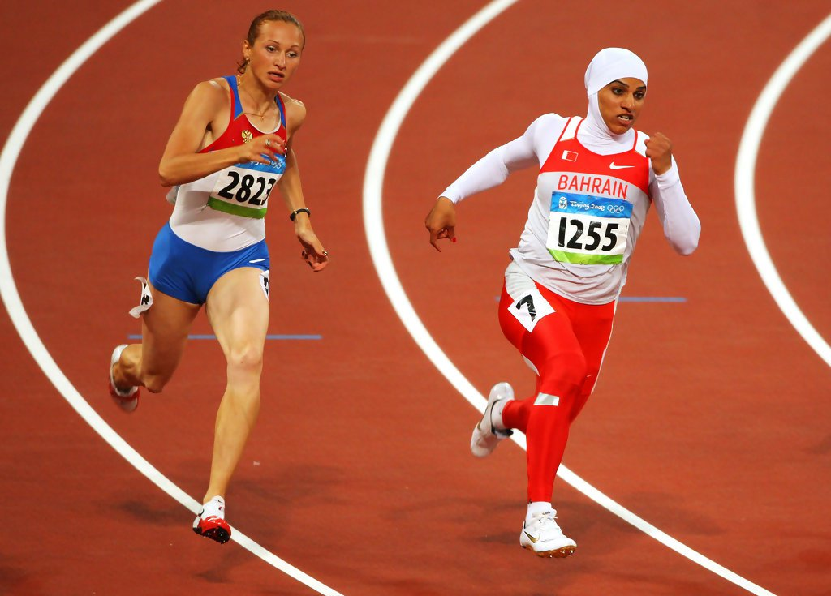
Islam and the West 2019 summer semester/course code: KHI/IW Monday: 15:00–16:30 | Instructor: Dr. Yasir Yılmaz The course is taught in English.
Are we today witnessing an unprecedented era in the relations between Islam and the West?
To what extent are the recent globally influential encounters between the West and a variety of “seemingly” Muslim actors a continuation of the past?
Is the history of the relations between the two worlds a story of conflict? In what areas did the two parties contribute to each other’s development?
Did Europe really become “Eurabia?”
Are the Muslim refugees who flooded Europe in recent years a new phenomenon in the Old Continent?
Does Turkey belong to Europe?
How come London and Rotterdam have Muslim mayors, while Christian mayors in Cairo, Islamabad, or Istanbul are inconceivable today?
Islam in America
This course will cover the history of the relations between the Islamic world and the West between the 7th and 21st Centuries. It aims to be a discussion platform for students from all disciplines who may carry out their own research.

Slide 11
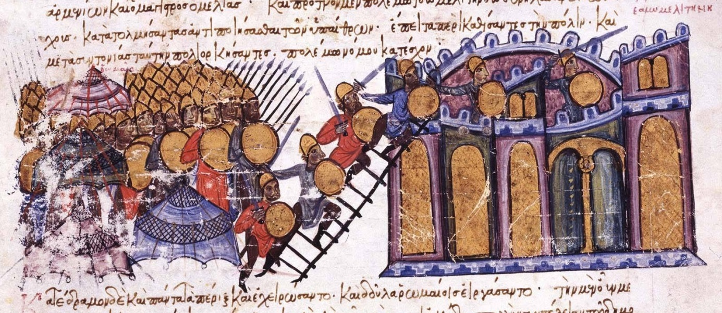
History and Fiction: Narrative Literature from Late Antiquity to the Renaissance
KKF/HF2| Summer Semester| Thursday, 9.45- 11.15 | Instructor: Dr. Florin Leonte
In this course we will explore examples of historical and fictional narrative beginning with late antique compositions and extending to late medieval texts. While we will focus primarily on individual works translated from Latin or Greek, we will also address their cross-cultural nature as well as their common ancient models. In particular, the course will address issues like the development of medieval narrative genres, the treatment of key historical events taking place in both East and West (e.g. transition from the ancient world, iconoclasm, crusades), or reader responses.

Slide 12
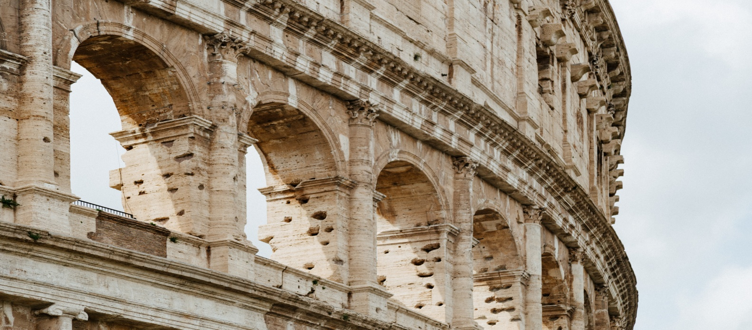
Roman Culture and Civilization
KKF/RCC2 | Thursday, 13.15- 14.45 || Instructor: Dr. Florin Leonte
This class is intended to introduce students to the world of Ancient Rome. It covers Roman history from the very beginning to the birth of the Eastern Roman Empire in the sixth century and provide an introduction to the major themes of Roman culture and social history. We will use a wide range of primary sources including literary texts, visual art, and archaeological evidence. Students will learn how to analyze these materials and understand the limitations and possibilities of the sources at our disposal for the understanding of the Roman World.

