Slide 1


PRACTICAL INFORMATION I.
Orientation Week / Summer Semester 2019/2020

Slide 2
What is on the program?
Who is Who (coordinators)
Documents – Safety and Health Protection (Report), Confirmations, LA
Registration of courses, Enrolment Form (EF)
European Health Insurance Card (EHIC)
Palacký University ID
Public Transport Card (Trampass)
Accommodation Rules (payment, deferred payment, deposit)
Accommodation Subsidy
Waste Management Municipality Fee
Czech Language Course
Academic calendar, national holidays, deadlines
Medical care, safety, shopping etc…

Slide 3
Students living out of the campus
Your duty is to report a place of your stay to the Foreign Police Dept.
Department of Foreign Police Olomouc
Smetanova 14, Olomouc
Tel.: +420 974 761 845, +420 974 761 841
Mon, Wed 8am – 3pm
Tue, Thu 8am – 12noon
EU country student - within 30 days
Visa student – within 3 days
Take the accommodation contract with you!

Slide 4
Reminder
Classes start officialy on Monday, February 10, 2020! Some dept./courses may start later! Check email from coordinators!
Exchange studens must be enrolled FULL TIME and receive minimum 15 ECTS per each semester, Erasmus International Credit Mobility students must receive min. 20 ECTS per each semester
You must notify the IRO if you decide to cancel your stay before the official end of classes.
You must notify the IRO as soon as possible of any change of address, legal name, and/or change of your major. If you do not live in dorms you must provide the IRO with an address of a place where you stay in.
Visa students must report any change of accommodation to the Dept. for Asylum and Migration (OAMP). An appointment there is scheduled by sending an e-mail request to IRO, namely to Ms. Yvona Vyhnanková (yvona.vyhnankova@upol.cz)
Mind the Smoking Ban in restaurants, public places!

Slide 5
Who is Who?
Institutional coordinator / Mrs. Yvona Vyhnánková (International Relations Office)
Incoming Student Coordinator / Zuzana Hamdanieh / Tereza Kalousková/ Eva Ohnisková and Klára Henzlová (general and practical issues)
Faculty coordinator (see the list of coordinators)
- each faculty has a Faculty International Relations Officer(s)
for international students (8 officers)
- deals with STAG/Enrolment Form, Accommodation Subsidy,
- prepares Final Transcript of Records
Departmental coordinator = Responsible Person
- information on courses, study plan
- person to sign your Learning Agreement/ guarantee your study plan

Slide 6
Faculty Coordinators
8
Faculty of Arts (Philosophical Faculty) | Simona.cerna@upol.cz
Faculty of Education | jana.dostalova@upol.cz
Faculty of Science | dana.gronychova@upol.cz
Faculty of Medicine & Dentistry | petra.nakladalova@upol.cz
Faculty of Physical Culture | Jitka.martincova@upol.cz
Faculty of Law | radana.kuncova@upol.cz
Faculty of Health Sciences | irena.jedlickova@upol.cz
Sts Cyril and Methodius Faculty of Theology | petra.hubena@upol.cz

Slide 7
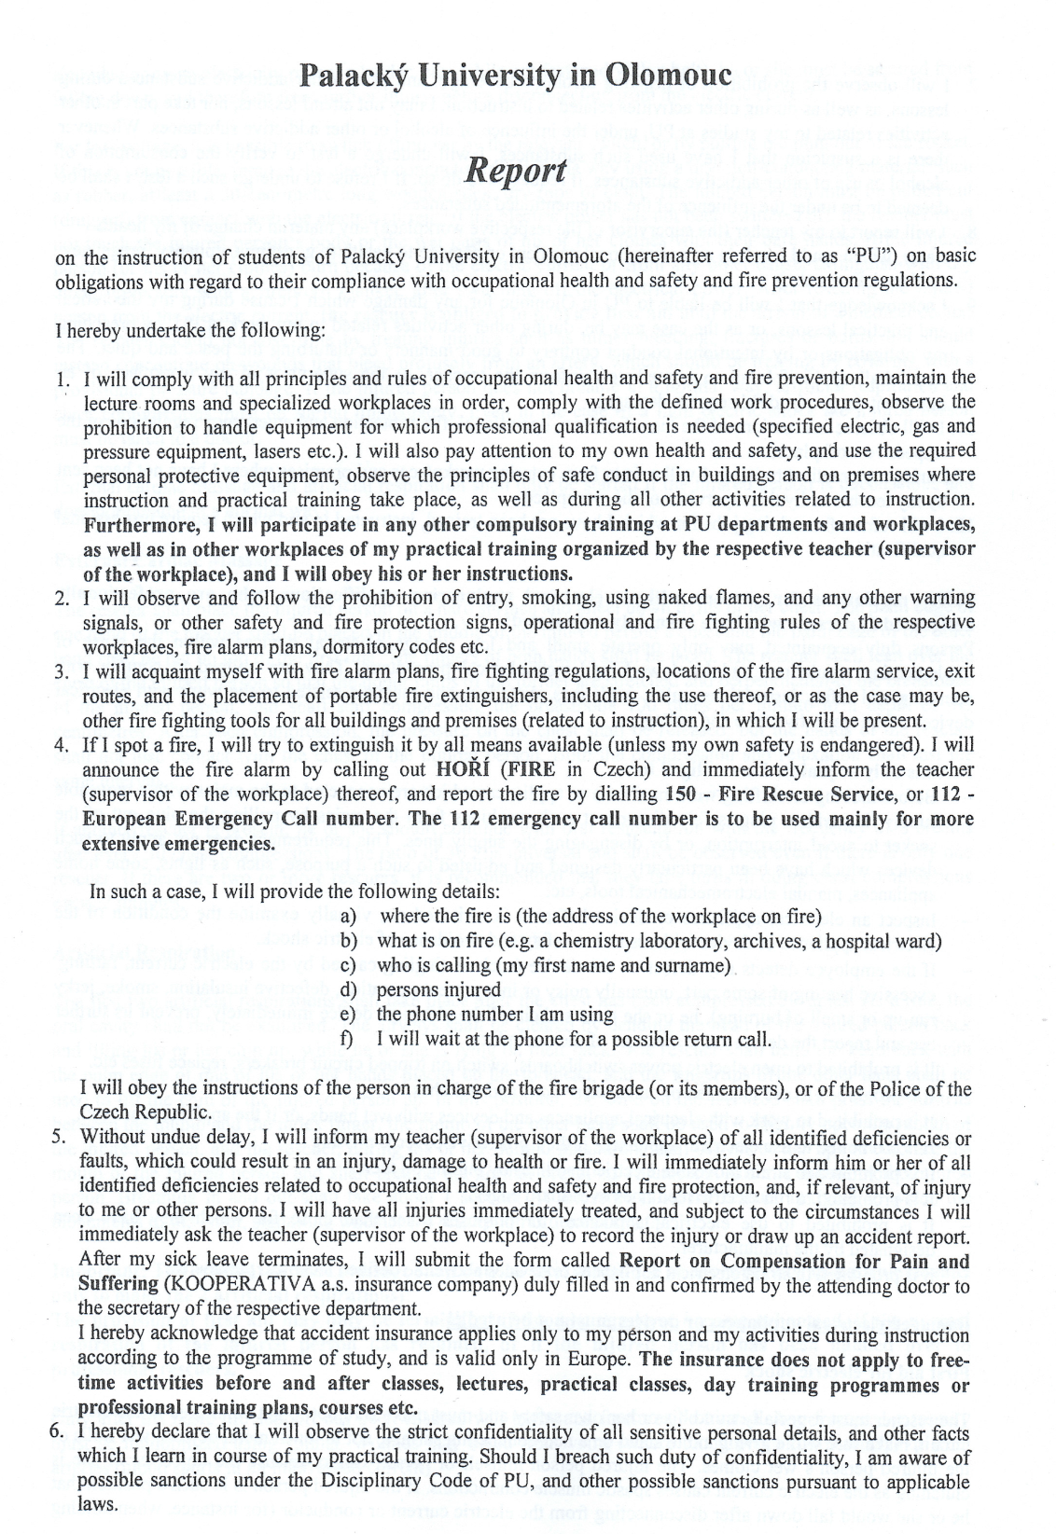
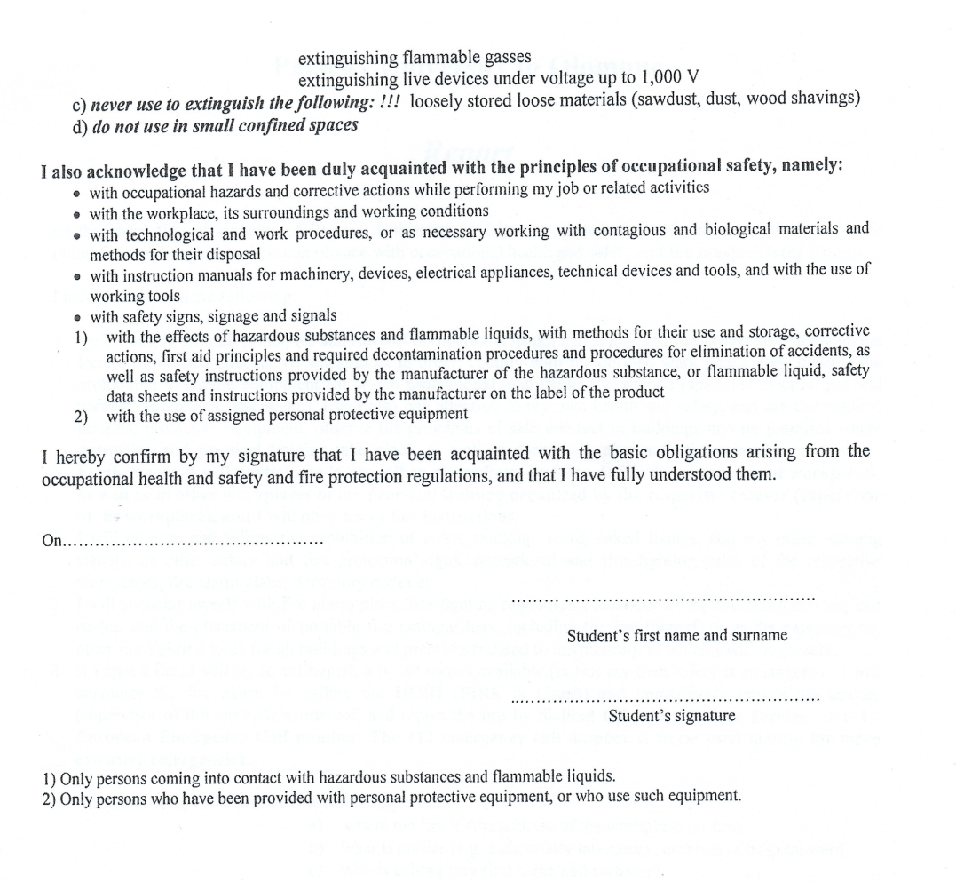
Please sign on the last page
Current Date
Name
Signature

Slide 8
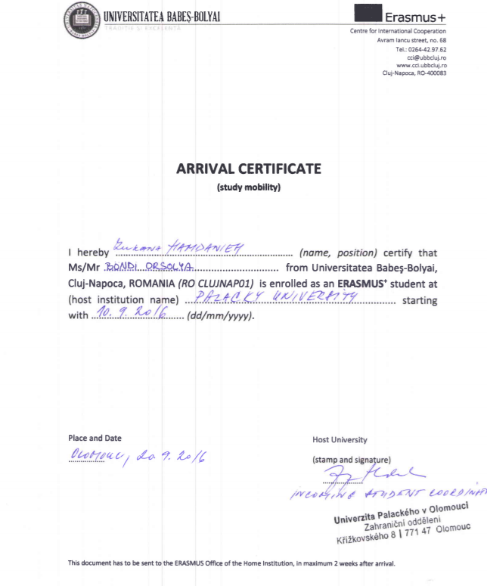
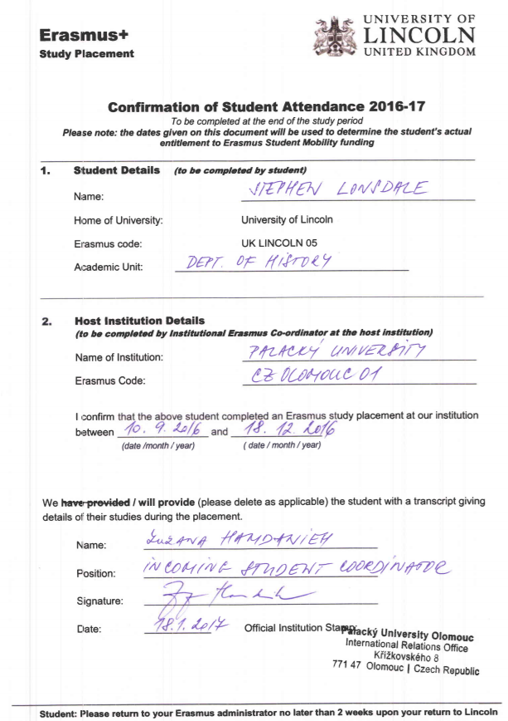
Confirmation documents – arrival certificate not required by all institutions – check instructions of your home institution
At the end of the study stay
At the beginning of the study stay

Slide 9
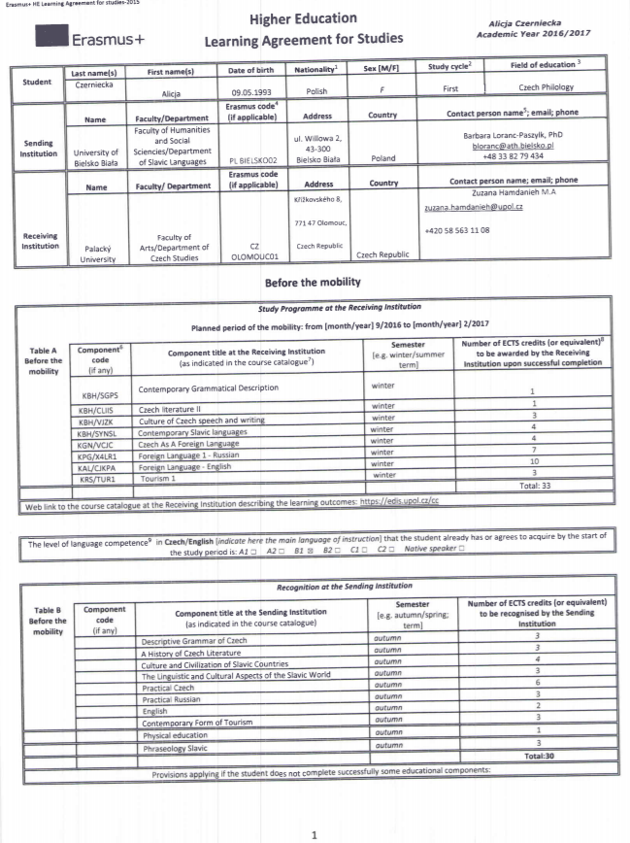
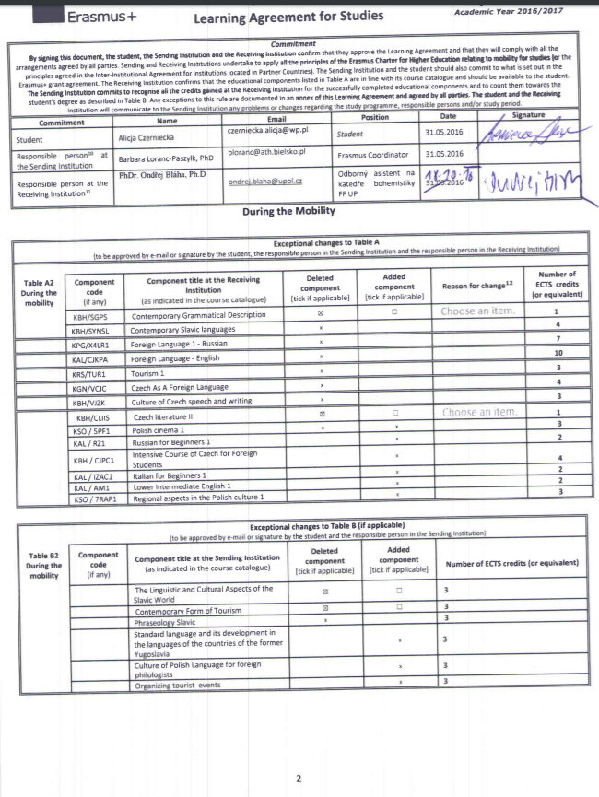
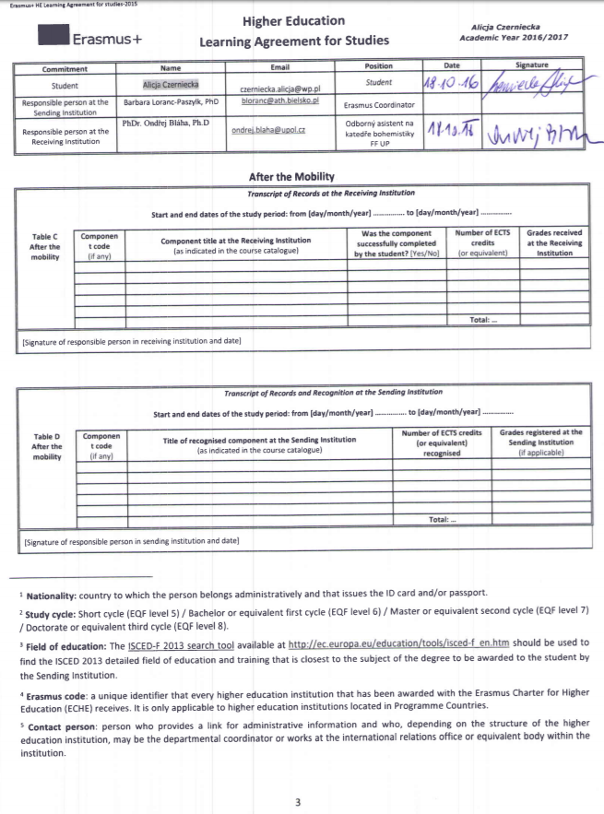
Learning Agreement
Before mobility
During mobility
After mobility

Slide 10
Registration of courses at Palacký University
ONLINE & PAPER
Online – STAG
(all students must have their courses registered in STAG)
Deadline – asap /different deadlines for faculties
Who does the registration in STAG?
Faculty of Arts – student!
Law – student + coordinator
Science – student + coordinator
Physical Culture – student + coordinator
Medicine – coordinator EF is used
Health Sciences – coordinator EF is used
Education – coordinator EF is used
Theology – coordinator EF is used
Paper – Enrolment Form(EF)
Deadline – 21. 02. 2020
Bring the Form(EF)with selected courses to the faculty coordinator.
Do not just rewrite courses from your Learning Agreement - there may be some changes!
It is important to deliver the „yellow card“ at the beginning and at the end of the semester!

Slide 11
Faculty of Arts
(majority of international students studies there)
Registration in STAG is done by the students themselves!
After 18.2. the capacity of courses increased
Registration possible till 27.2.
LA Changes must be delivered (whether or not confirmed by teachers) in person before 10.3.2020 to Ms. Simona Černá, Faculty of Arts, Křížkovského 10
It is important to participate in the meeting on Wednesday (05. 02. 2020) in the morning!

Slide 12
Enrolment Form/ „yellow card“
Required at the Faculty of Education, Medicine, Health Sciences,
Theology
It is necessary to fill in the form as soon as possible upon your arrival.
Have the form confirmed by UP teachers.
Bring the confirmed form to your faculty coordinator in order to do/check your registration in STAG - by 21. 02. 2020

Slide 13
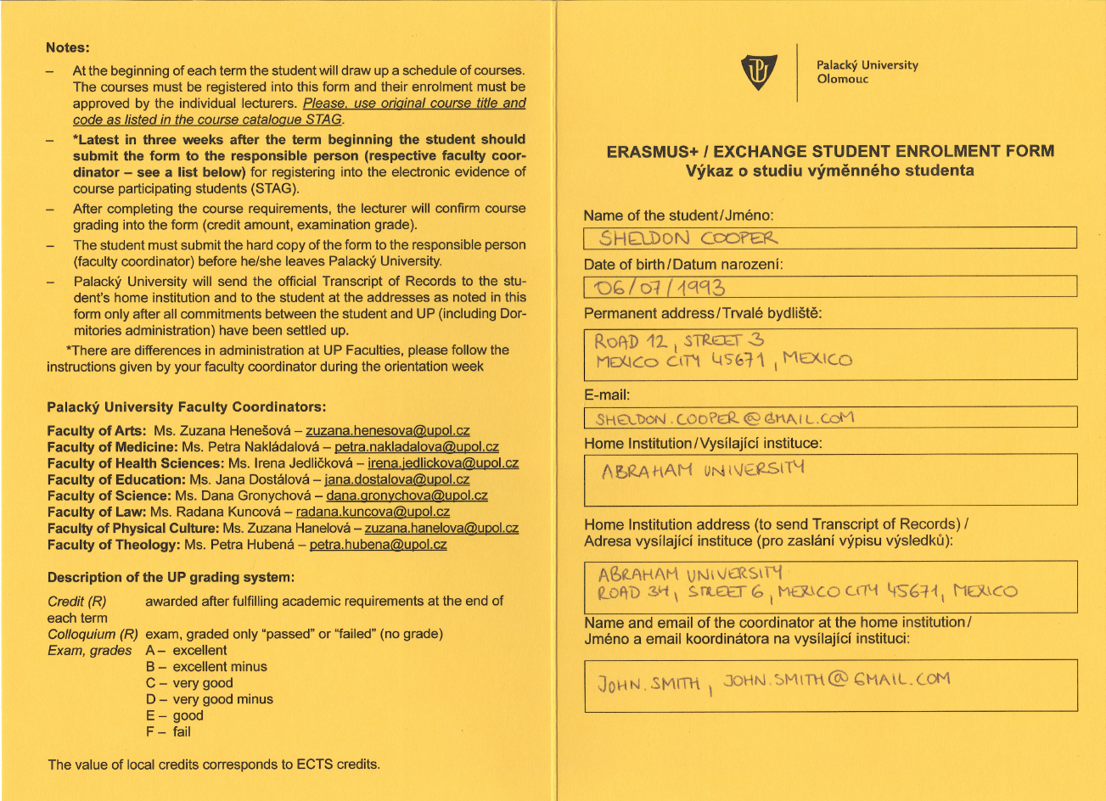
Check your faculty coordinator Jitka.martincova@upol.cz
(Faculty of Physical Culture)
Fill in the front page!
Ms. Simona Černá – Simona.cerna@upol.cz
Important!

Slide 14
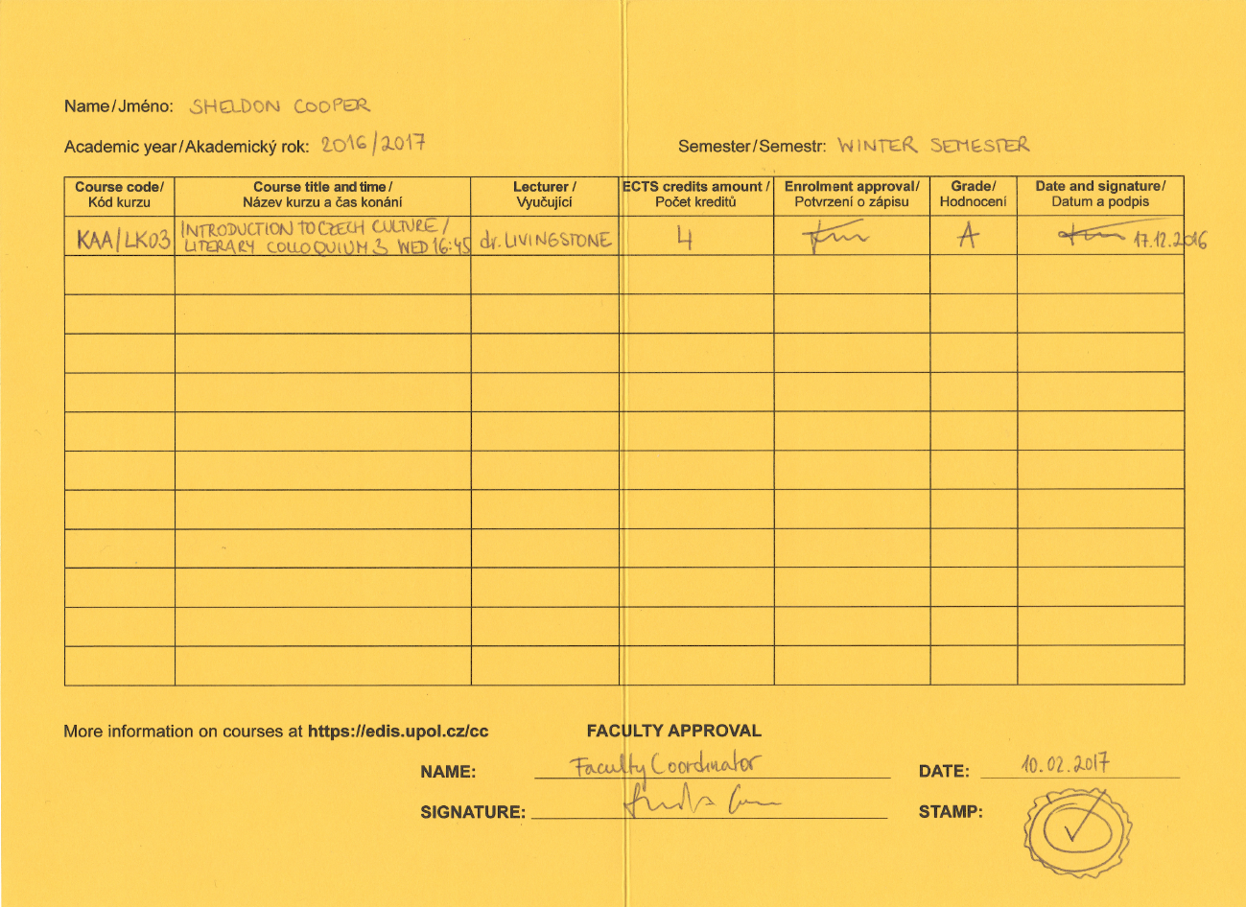
Summer Semester
2019/2020

Slide 15
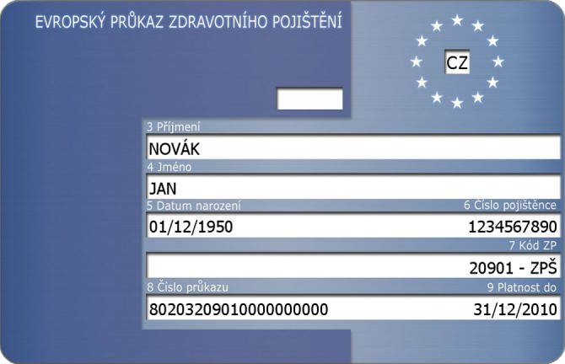
Check the date

Slide 16
European Health Insurance Card (EHIC)
Registration of valid health insurance can be arranged via International Relations Office, based on the valid EHIC.
Upload a copy of VALID EU health insurance card/document into the Online Application /Appendices by 10. 02. 2020
Only valid insurance can be registered. Check the expiration date of your card in the UP online application - appendices
When the registration is approved, students will be notified via e-mail.
Students who need to see the doctor urgently can individually contact the IRO to request the registration with priority.
Commercial/private insurance – no registration

Slide 17
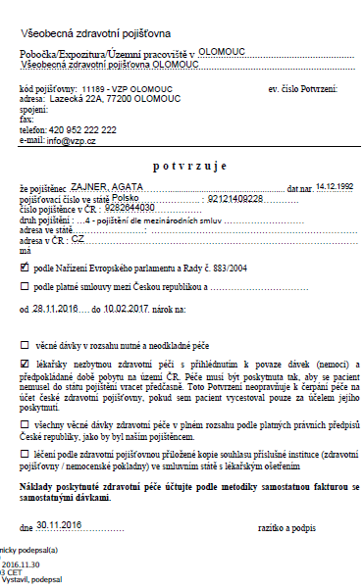

Slide 18
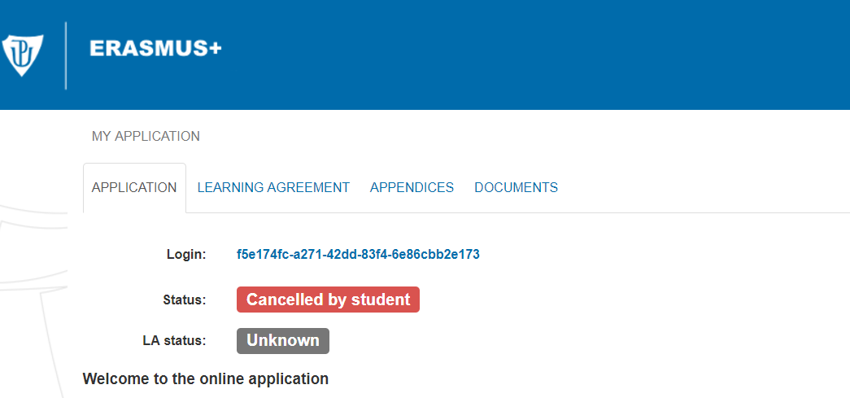

Slide 19
Counselling & Medical Care
Medical Care (more info https://www.upol.cz/en/students/guide/counselling-medical-care/)
There is a basic Healthcare Centre in Envelopa (J. L. Fischer Dormitory, Šmeralova 10) currently without a general practicioner, now only a dentist and gynaecologist are available there. Although the doctors can speak basic English, we recommend bringing a Czech-speaking friend along (your buddy), if possible.
Registration of your heath insurance document required!
Olomouc University Hospital, Emergency ward located in the Surgery Clinic (blue building) - so called „urgentní příjem/pohotovost“
Office hours on working days: 3 pm – 7 am, on weekend 7 am -7 pm
Dental Emergency (24/7) - Olomouc University Hospital, I. P. Pavlova 185/6, KÚČOCH (Dept. of Oral and Jaw Surgery).
For medical issues that require attention within 24 hours please try to come by 8 pm.
During night hours 22 -7 please come only for medical issues which require immediate care (injury, bleeding)

Slide 20
Counselling & Medical Care
Special Needs Centre
Address and contact: Faculty of Education, Žižkovo nám. 5, Olomouc,
tel.: +420 585 635 323, mobile phone: +420 775 124 696,
email: lucia.pastierikova@upol.cz
Psychological Counselling
the Counselling Centre of the Department of Psychology and Psychopathology, FoE, UP. Email: jana.kvintova@upol.cz. Likewise, students can get psychological help at the UP FoM. Contact the Study Department for more.

Slide 21
For other medical specialists and services, visit the main Olomouc healthcare centres such as:
Health Centre "Poliklinika" Olomouc, třída Svobody 32
  www.poliklinikaolomouc.cz
  Health Centre „SPEA“
  nám. Národních hrdinů 769/2, 779 00 Olomouc
  www.spea.cz
  Olomouc University Hospital, I. P. Pavlova 6
  www.fnol.cz, www.fnol.cz/pdf/fnol_cz_mapa.pdf

Slide 22
Palacký University ID Card
Standard Blue Card (200,- CZK) or ISIC (450,-CZK)
1.No form! Open your UP online application, new section
„AFTER ARRIVAL“
2.Pay a deposit of 200/450 CZK
3.The ID card is issued in Zbrojnice (Central Library) within a week upon the request was submitted. ID cards are taken individually during the office hours (check the status regularly to know when the card is ready for you).
Join Practical information 2. to know where the ID card office is located.
ID cards office will be open on Monday, 10.2.2020 at the earliest due to technical reasons!

Slide 23
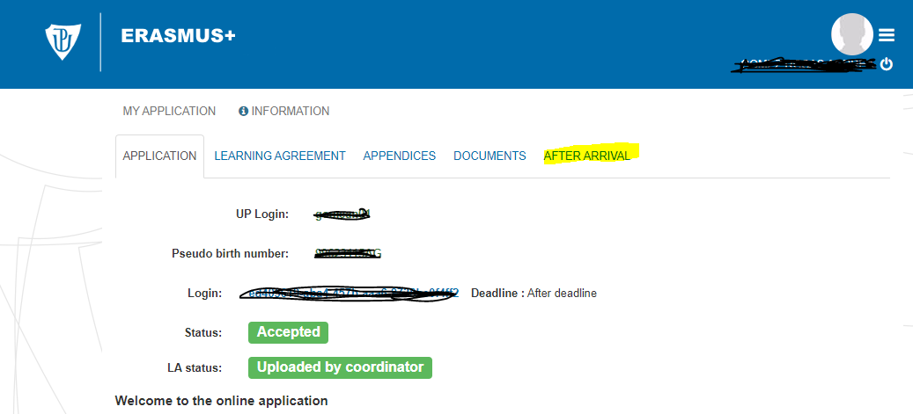
How to arrange your Palacký University ID CARD?
Enter the UP Online Application

Slide 24


Choose your UP ID Card in the online application both cards provide the same services within UP
ISIC + UP ID Card = two in one
450 CZK (200 deposit + 250 payment)
Valid till December 2020
UP Standard Blue Card
200 CZK deposit
Valid for the time of a study stay

Slide 25
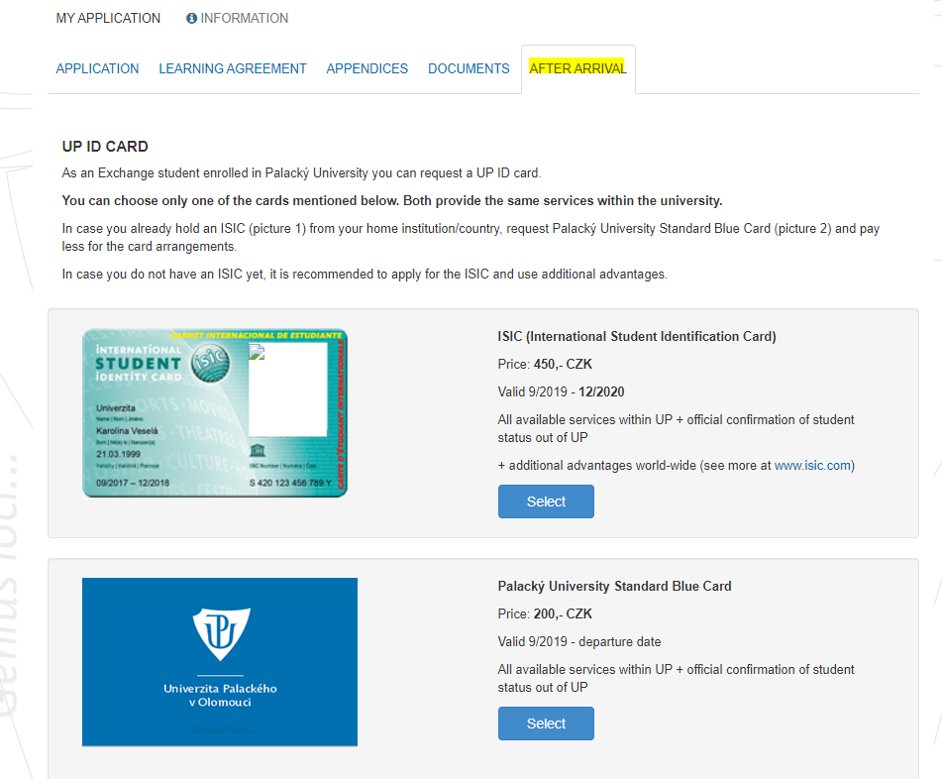

Slide 26
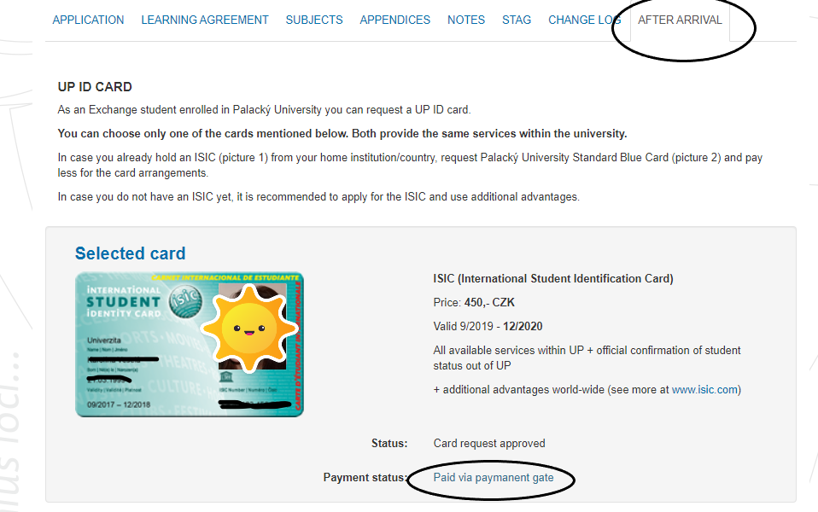

Slide 27
Palacký University ID Card
24 hours after printing ready for full use
Library
Computer Halls
Dining Hall – Envelopa or Neředín – meal orders
Problems with meal orders: Main Dining Hall at Envelopa, 17.listopadu street - dormitory representative Mr. Jaroslav Vrba – Jaroslav.vrba@upol.cz
Discount prices

Slide 28

Staying at Palacký University Dormitories
Read your contract!
If you change the date of your departure, inform the accommodation office and have a change recorded in your contract, at least one month notice period!
Keep the rules – mainly: no noise during night hours, no alcohol, drugs, smoking, keep your place and cooking areas clean, no pets are allowed, return the key of the laundry room in time, otherwise you pay for extra time! ….
Breaking the rules can cause an end of your stay there, your home institution will be informed !
„Shopping carts are the property of the shopping centers –
e.g.Globus supermarket!

Slide 29
Accommodation Subsidy
A portion of money given only to Erasmus+ (KA103) students to support their accommodation expenses
Summer semester portion is paid for February, March, April, May, (June) – 5 months/ 780,- CZK per month
Always available at the end of the semester (in May) at the main cash desk, Křížkovského 8
Subsidy cannot be paid in advance
Paid in cash (CZK)
No application form
Necessary to inform the faculty coordinator about a departure date if your stay ends up earlier (March/April)

Slide 30
Waste Management Municipality Fee
Required from everybody staying in Olomouc for more than 3 months ( 90 days)
Fee of 816 CZK per year
Information available in dorms (reception desk)
Payment is requested by the Municipality of Olomouc, Economic dept., office of municipal fees, based on the Municipal Council decision (order no.14/2019).
Information is also available on the web of the town (in Czech language):
https://www.olomouc.eu/aktualni-informace/aktuality/15246
Also on the UP web in English /Exchange Students/ News and Reminders
http://www.upol.cz/en/students/exchange-students/news-and-reminders/
Zuzana Hamdanieh, International Relations Office

Slide 31
Public Transport Card / Student Pass
1. Fill in a form and add a passport size photograph
2. Have the form confirmed in the International Relations Office
( an ISIC proves your student´s status, it can substitute the confirmed form)
3. Go to the Public Transport Agency, Legionářská street no. 1 (center of the town, see the map with your buddy), submit a photo + confirmed form /ISIC
4. Buy a trampass ( prices below are valid for students below 26)
10 months trampass / 1350 CZK
3 months trampass / 450 CZK
1 month trampass / 175 CZK

Slide 32
2019/2020
DD/MM/YYYY
Current Date
Current Date

Slide 33
Czech For Foreigners´Courses
Survival Czech Course / a lecture during orientation week
Semester course / two 9o min lessons per week
Placement test: Not for beginners !
Test assignment available at www.kb.upol.cz (Czech for Foreigners, Erasmus), deadline for sending the test is February 10, 2020. Results will be sent to the e-mail address of the sender.
To view the timetable - check the web: www.kb.upol.cz or information board in the International Office.

Slide 34
Czech For Foreigners´Courses
CJPC2 – Czech for Foreigners – course – 4 ECTS
CJPCZ2 – Czech for Foreigners – exam – 1 ECTS

Slide 35
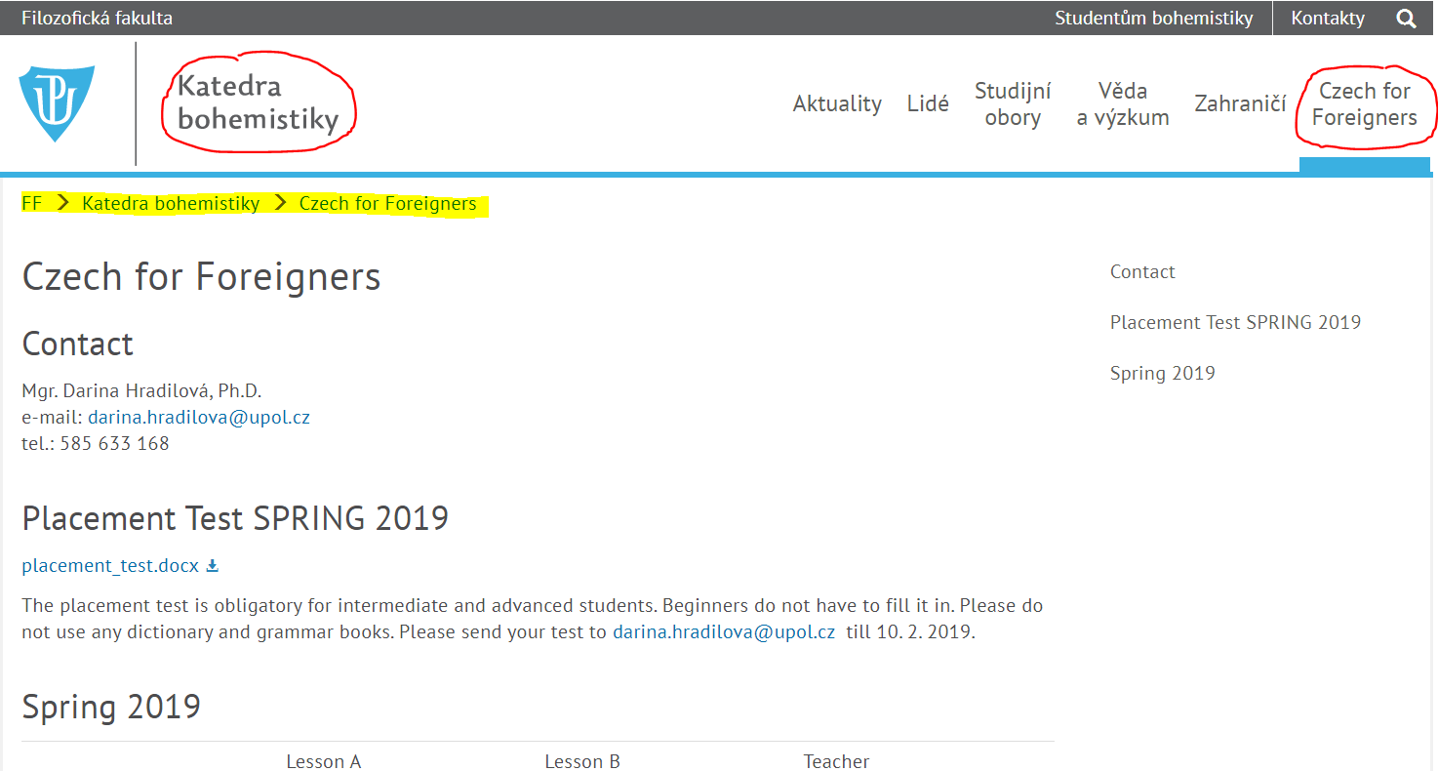
www.upol.cz https://kb.upol.cz/czech-for-foreigners/

Slide 36


Interdisciplinary Courses – see more on the UP web https://www.upol.cz/en/students/exchange-students/news-reminders/#c39681

Slide 37
Public Holidays in the Czech Republic
Easter – Friday, April 10 - Monday, April 13, 2020
May 1 – Labour Day
May 8 – Liberation Day
Offices and some stores are closed !
May 13, 2020 – UP Sport Day

Slide 38
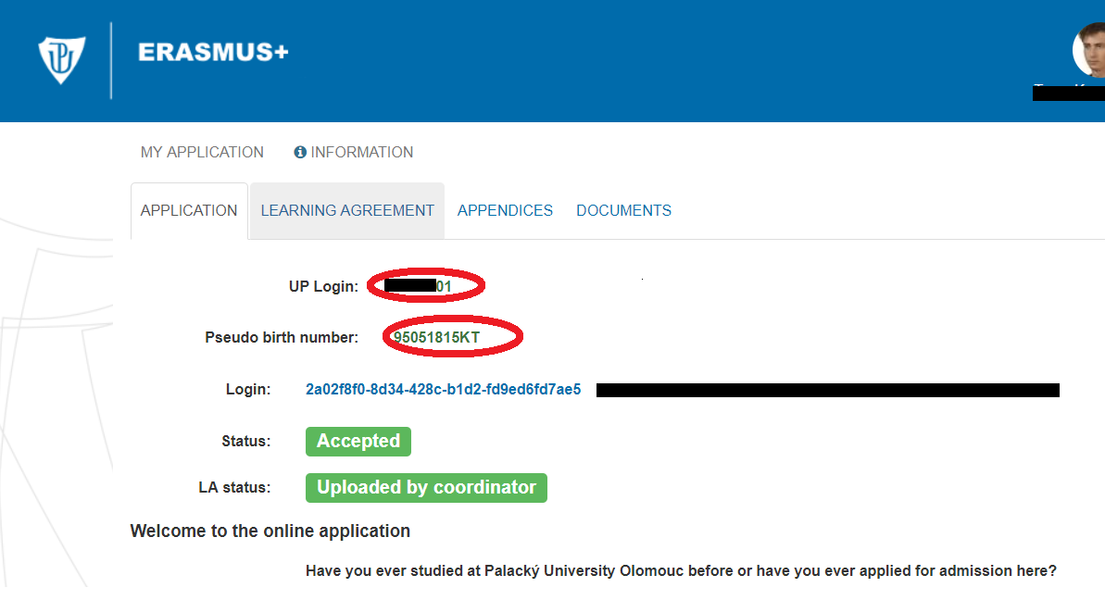
Access into the UP online application after arrival
Via link received at the very beginning of the application process
Via UP Portal – using UP login (Portal ID) and password
Haven´t received a notification e-mail with UP login and password?
Check information in the online application! Contact IRO!

Slide 39
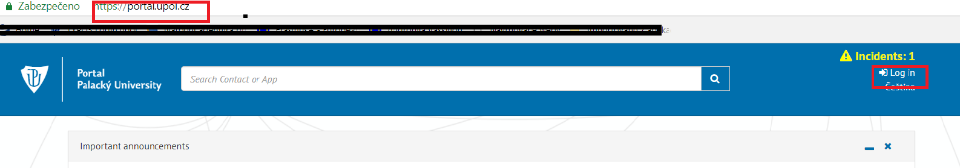
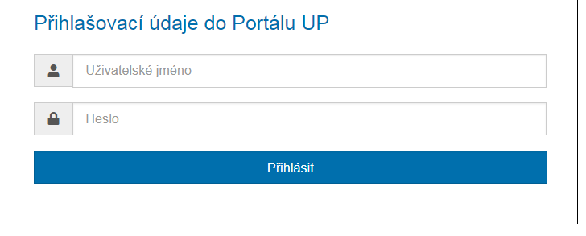
Using UP Portal

Slide 40
Using UP Portal

Slide 41
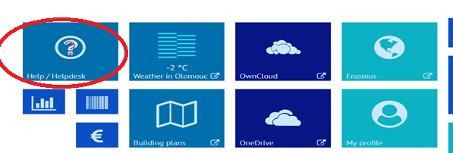
Information sources
Visit the web of IRO at https://www.upol.cz/en/students/
Visit the web of your UP Department/Faculty
FB
Current password to UPOL Wifi network is: studujup2020
A new password you can view in Portal via Help/Helpdesk

Slide 42
How can I protect myself from catching the new coronavirus?
By today there is no positive case reported in the Czech Republic.
Hand hygiene is the first and most important line of defence.
Avoid touching your eyes, nose, and mouth with unwashed hands
Other tips include:
Carry a hand sanitiser with you to make frequent cleaning of hands easy
Always wash your hands before you eat
Be especially careful in busy airports and other public transport systems about touching things and then touching your face
Carry disposable tissues with you and always cover your nose and mouth when you cough or sneeze before disposing of the tissue carefully (catch it, bin it, kill it)
Do not share snacks from packets or bowls that others are dipping their fingers into
Avoid shaking hands or cheek kissing if you suspect viruses are circulating
Regularly clean, not just your hands, but commonly used surfaces and devices you touch or handle
Avoid sharing household items
You should not share dishes, drinking glasses, cups, eating utensils, towels, bedding, or other items with other people. After using these items, you should wash them thoroughly with soap and water.

Slide 43
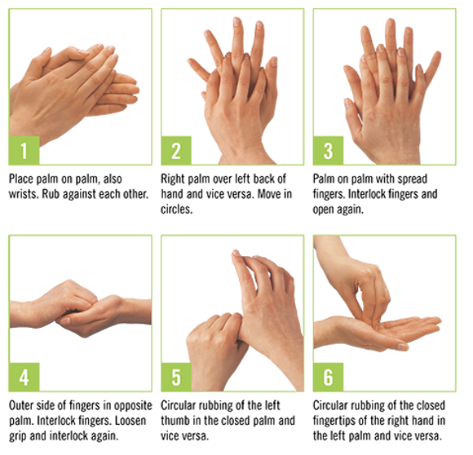
Hygienic Hand Disinfection for 30 seconds!

Slide 44
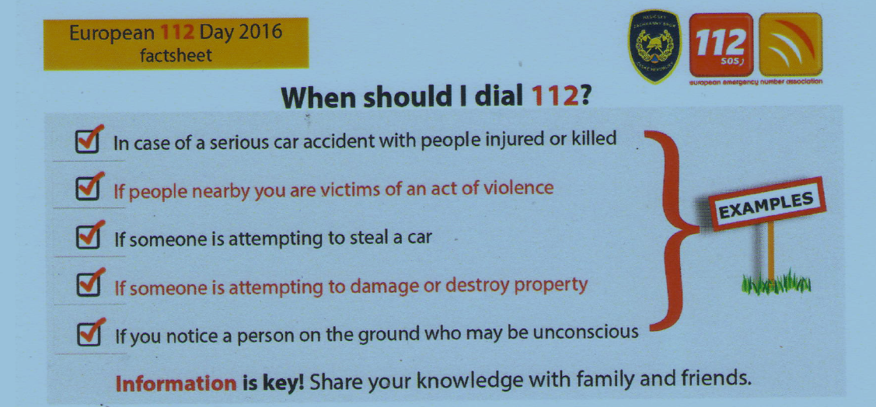

Slide 45
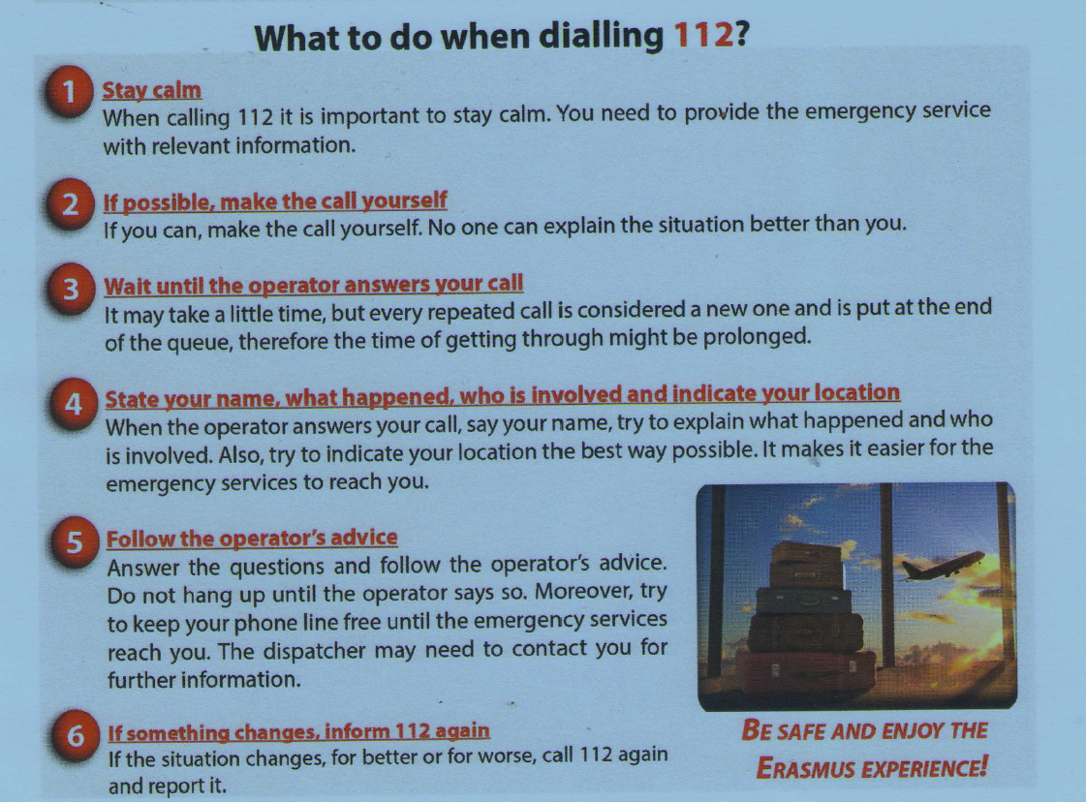

Slide 46
Meeting Departmental Coordinators – check your email
(Responsible Persons) – list of all available on the web
Faculty of Physical Culture – Wednesday, 6.2. at 2 p.m., Neředín campus, building AB, room NA 410 –meeting with the coordinator (only Faculty of Physical Culture students)
Faculty of Law – only Faculty coordinator – pre-registation on 11.02.2020 /meet coordinator individually within the office hours
Faculty of Medicine – meet the coordinator individually any time
Faculty of Theology – meet coordinator upon agreement/ Christian Social Work students on Tuesday, 18.02.2020 at 10.45, Na Hradě, 4th floor, room 4.15
Faculty of Health Sciences – meet the coordinator individually any time
Info by e-mail/ meeting at the dept. or individually if no meeting scheduled:
Faculty of Science – dept of Geography, Tuesday, 11.02.2020 at 10 am, main building, room 2.027, dr. Šimáček
Faculty of Education
Faculty of Arts - Wednesday, 05.02. at 9 a.m, room 3.05, meeting with the Faculty coordinator !!!

Slide 47
Meeting Departmental Coordinators
(Responsible Persons) – list of all available on the web https://www.upol.cz/en/students/exchange-students/departmental-coordinators/
Political Science Dept. (FoA)
Ms. Markéta Zapletalová
Wednesday, 12.02. 2020 at 12.00
Křížkovského 12, room 1.09
Psychology Dept. (FoA)
Ms. Kateřina Palová
Monday, 10. 02. 2020 at 10.00
Vodární 6, room 232
English Dept. (FoA)
Ms. Markéta Janebová
Monday, 10. 02. 2020 at 16.45
Krizkovskeho 10, room 1.39, ground floor

Slide 48
Practical Information II.
Guided tour with a Czech student / guide of the group
Central Library
British Library
University services: Computer Hall, Xerox, ID Card Office, Cash desk, Bookshop,
Basic orientation – departments
IF YOU MISSED THE PRACTICAL INFO 2, PLEASE ASK YOUR BUDDY FOR HELP ☺

Slide 49

Meeting Departmental Coordinators
(Responsible Persons) – list of all available on the web https://www.upol.cz/en/students/exchange-students/departmental-coordinators/
Slavonic Studies Dept.
Mr. Jan Jeništa
Mo - Wed - 10:30-11:00
Křížkovského 10, room 4.31A (FoA)
Dept. of Applied Economy
Ms. Pavla Slavíčková
Křížkovského 12, room 3.08 (FoA) during office hours
Musicology Dept.
Mr. Jiří Kopecký
Univerzitní 3, Arts Centre (Konvikt)
Theatre and Film Studies Dept.
Mr. Milan Hain
Univerzitní 3, Arts Centre (Konvikt), 2nd floor, door 231

Slide 50
Meeting Departmental Coordinators
(Responsible Persons) – list of all available on the web
Institute of Education and Social Studies (FoE - Žižkovo náměstí 5)
Ms. Jitka Plischke
Faculty of Education main building, on the right, room P8
Primary Education Dept. (FoE - Žižkovo náměstí 5)
Ms. Alena Vavrdová
Faculty of Education main building
English dept. (FoE - Žižkovo náměstí 5)
Ms. Jana Koříková (e-mail her to set an appointment)
Faculty of Education main building, 3rd floor
Dept. of Mathematics
Ms. Martina Uhlířová

